Slide 1



Welcome!

Slide 2
Welcome to Neuromatch Academy!!
A global community of 8,000+ computational neuroscientists
undergraduates, graduate students, postdocs, faculty, industry
Launched April 2020 in response to
COVID-19 canceling compneuro summer schools
typical summer schools are expensive, inaccessible by many
Notes:
And now that I’ve introduced myself, we can get right on with welcoming you all very warmly to Neuromatch Academy! As a TA in this program, you’re now part of a global community of over 8,000 neuroscientists from around the globe, who are all interested in learning how to build and apply computational models of all sorts to their research in school and in their professional careers. The Neuromatch Academy community includes students, postdoctoral researchers, faculty at institutions around the globe, and industry professionals who all have this one thing in common, and over the next three weeks we’re gonna take quite a journey together.
And don’t let our size fool you: Neuromatch Academy is actually very young! We only decided to launch this program only a few months ago, back in April, and we’ve been working like crazy to make it a success for you all. The catalyst for launching the program was that COVID19 is canceling all these summer schools around the country and the world, but we also recognized very keenly that these summer schools are expensive, they’re exclusive, and so they’re inaccessible by many students geographically or economically. So we wanted to do something to fix that. And we’re really glad you’re here to help us.

Slide 3
TA training
Notes:
Let’s dive into TA training...

Slide 4
Overview of TA training
NMA philosophy
TAs as facilitators of learning
Problem-based learning
Motivation
Giving / Receiving Feedback
NMA-specific Knowledge
Technology
Leading Tutorials
Group Projects

Slide 5
TA Training Schedule
Day 1
Day 2
Day 3
Day 4
Day 5
welcome
tech stack
group projects
Python Workshop
Python Workshop
principles of learning
leading tutorials
D1 / D2 training
student motivation
tech stack
in practice
python workshop prep
feedback
tutorials practice
python workshop prep
pre-course
Q&A
Q&A
Q&A

Slide 6
The Neuromatch Academy philosophy...
Science
What is modeling? What does it buy us? How do we get it right?
Teach students to select and use state of the art computational neuroscience & modeling approaches
Worldwide impact, inclusivity and equity
Learn anywhere, provide access to excellent computational neuroscience education, and community building opportunities for every student regardless of location or financial means

Slide 7


Your pod
pod (1 TA)
you
group projects
group projects
~10 students/TA
Multiple pods grouped together for discussions

Slide 8
TA overall structure
megapod (6-8 TAs) (one TA is lead TA)
TA Q&A sessions
superpod (3-4 TAs)
superpod (3-4 TAs)
pod (1 TA)
pod (1 TA)
pod (1 TA)
pod (1 TA)
group projects
group projects
group projects
group projects
group projects
group projects
group projects
group projects
pod (1 TA)
pod (1 TA)
pod (1 TA)
pod (1 TA)
group projects
group projects
group projects
group projects
group projects
group projects
group projects
group projects

Slide 9
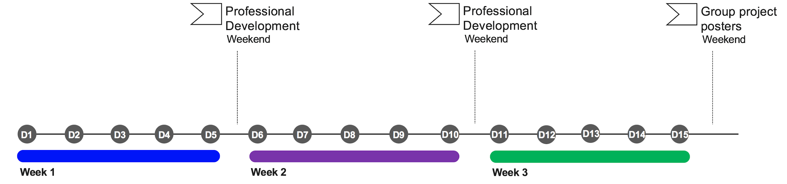
Schedule
Day 1: What do models buy us?
Day 2: How to build models
Day 3: Model fitting
Day 4: Machine learning (ML) - decoding
Day 5: Dimensionality reduction / manifolds
Day 6: Bayes
Day 7: Time series 1 (linear systems)
Day 8: Time series 2 (decision making)
Day 9: Optimal control
Day 10: Reinforcement learning (RL)
Day 11: Real neurons
Day 12: What happens in dynamic networks?
Day 13: Causality & networks
Day 14: Deep learning (DL) 1
Day 15: Deep learning (DL) 2
Notes:
But that’s the philosophy -- what are we actually going to do over the next 3 weeks?
We’ve got a really exciting schedule lined up for you: three weeks of packed tutorials and hands-on education, with professional development like career panels, data management, scientific communication and professional networking opportunities on the weekends, and then we’ve also got these group project presentations to wrap up the program.
Week 1...

Slide 10
The daily schedule
“morning”
“evening”
2 hrs
A
project
tutorials
tutorials
break!
B
project
tutorials
tutorials
project
C
tutorials
tutorials
project
Zone 1: East Asia + Pacific
Zone 2: Europe, Africa, Middle East
Zone 3: Americas
Zone 2: Europe, Africa, Middle East
Notes:
And remember, this is a global community so we’ve spent a lot of time figuring out the schedule and timing so everybody can do stuff live and in person with their pod without having to get up in the middle of the night.
This means you all are grouped into 3 time zone groups, Zone 1, Zone 2, and Zone 3. Your zone group is available in your student portal, and this means that your whole pod is in one of these zones.
In each timezone group, your day looks something like this.
In the morning, many of you will get up and work on your group projects, once they’ve kicked off. Then you’ll have a block of tutorials, a break, another block of tutorials, and then you’re done.
That’s track A.
In track B, you might wake up a little later, and do only a couple hours of project work in the morning, followed by the tutorials, and then do a little more project work afterwards.
And in track C, you’ll start with the tutorials and do your group project work afterwards.
You’ll only be in one of these tracks, and it’s based on your actual timezone and preferences that you put into your profile. Make sure you check your student portal so you know which timezone group you’re in!

Slide 11
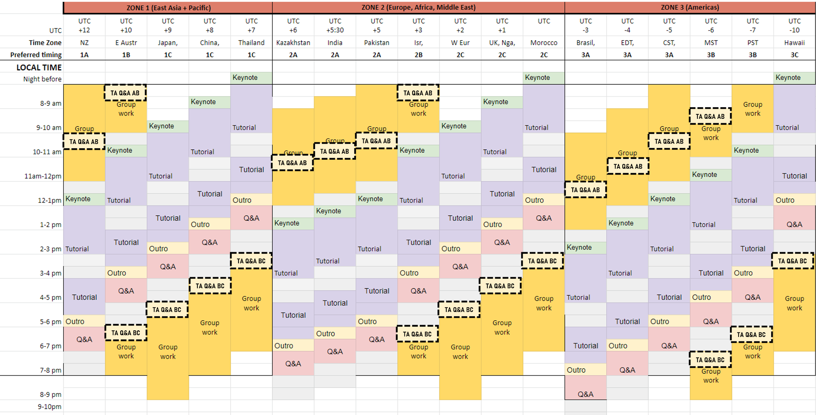
TA office hours
https://colab.research.google.com/drive/1IfyXSrOwWtkEu5o9PYVwY6zbQ_9PGd8g

Slide 12
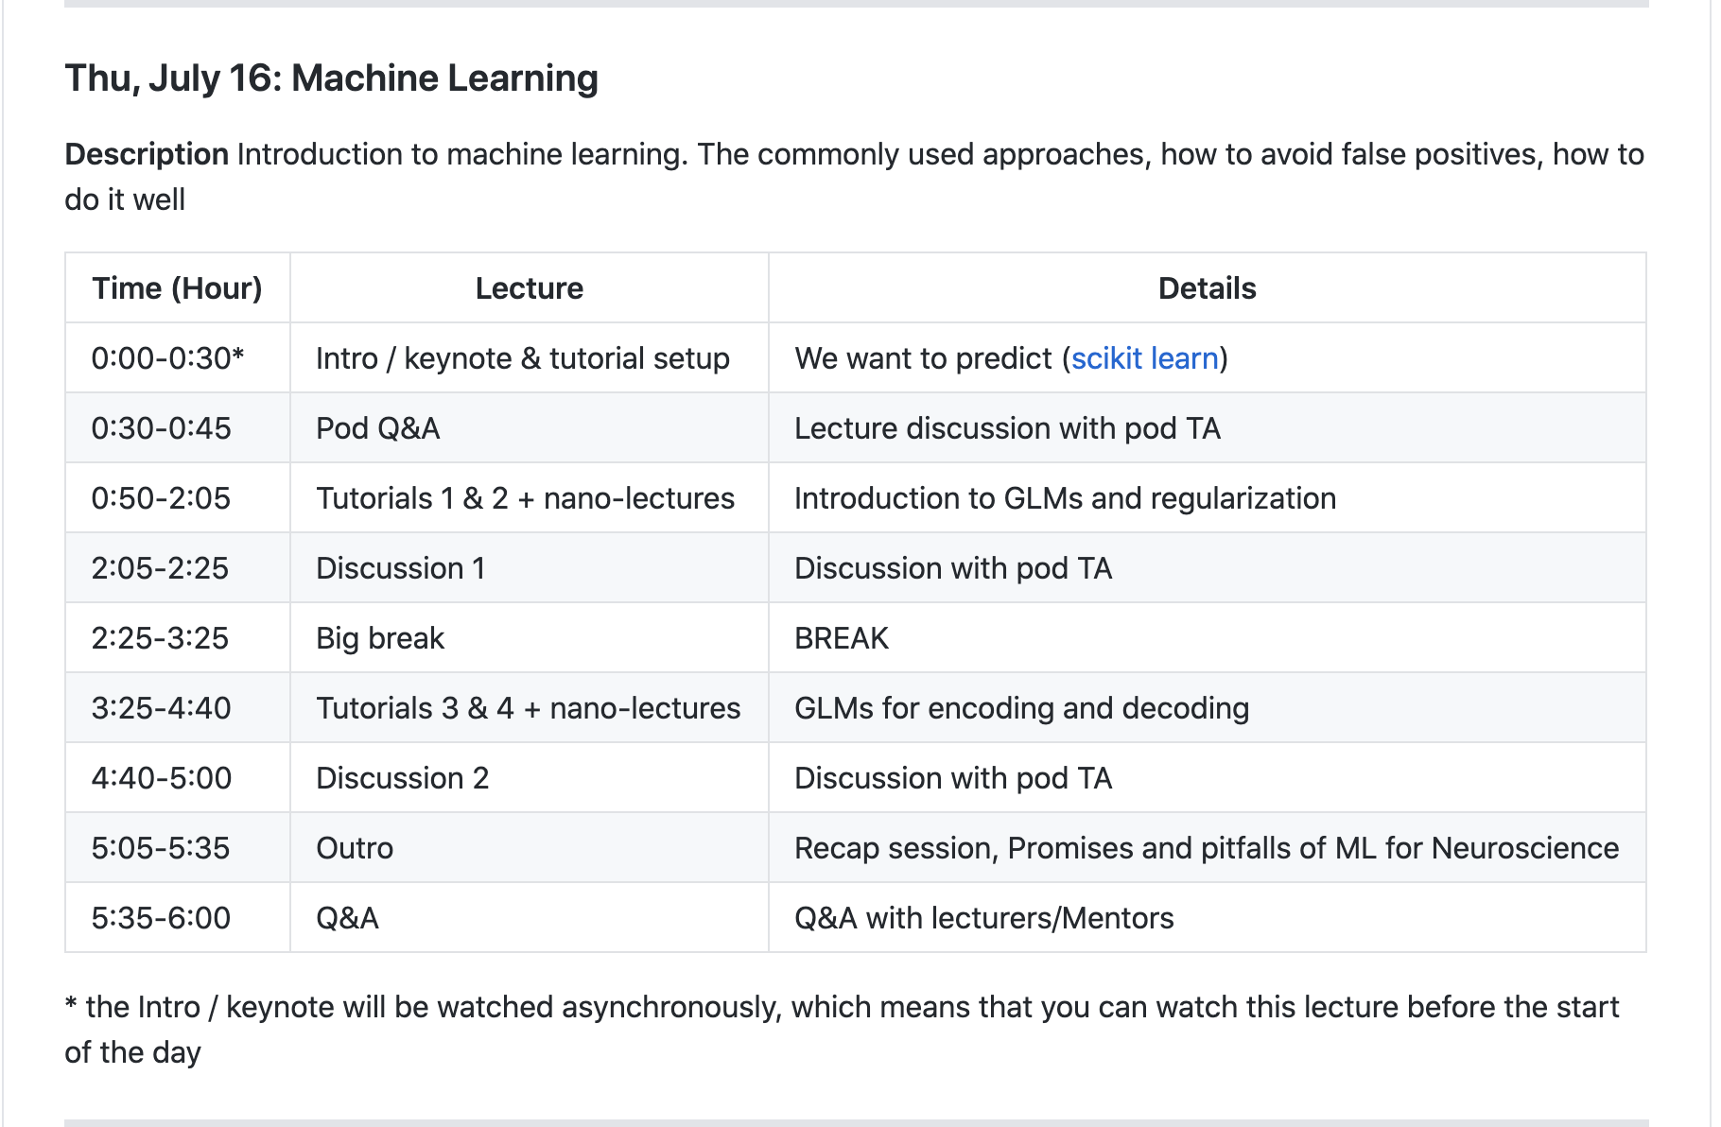
The daily schedule - a closer look
TAs manage time
https://github.com/NeuromatchAcademy/course-content
Ensure everyone is present for tutorial set-up / Q&A
Pod Q&A: start tutorial if done
Discussion: finish tutorials if needed
Ensure everyone is ready for mid-day break + activities
Ensure everyone is ready for broadcasting: Outro / Q&A

Slide 13
TAing
That’s where YOU come in...

Slide 14
Roles & responsibilities
You will be a learning facilitator, mentor and first contact point for your pod of students!
Ensure code of conduct is respected
Ensure students progress well through tutorials
Divide your time equitably between students and groups
Support student group projects
Notes:
We’ll talk more about your role in tutorials and group projects in coming session. I’d like to spend a few moments talking about the Code of conduct and the NMA philosophy on inclusion.

Slide 15
Code of conduct
1. Be inclusive.
Welcome and support everyone - any sexual orientation, gender identity and expression, race, ethnicity, culture, national origin, social and economic class, educational level, color, immigration status, sex, age, size, family status, political belief, religion, and mental and physical ability.
4. Choose your words carefully.
Conduct yourself professionally when you write and speak, and be kind. Do not insult, harass, or put down others.
5. Don't harass.
In general, if someone asks you to stop something, then stop. Try to resolve disagreements and differing views constructively.
2. Be considerate.
Think about how your decisions affect your fellow students, your TAs, and your colleagues around the world.
6. Make differences into strengths.
We have strength in our diversity. Different people have different perspectives on issues, and that can be valuable for solving problems or generating new ideas.
3. Be respectful.
Disagreement is no excuse for disrespectful behavior.
https://docs.google.com/document/d/1TF7Er5QVcej_OQde0vUq92G58hUX2MBEregc_jXVBhw/

Slide 16
Diversity includes all the ways that people differ. A broad definition includes not only race, ethnicity, and gender — the groups that most often come to mind when the term "diversity" is used — but also age, national origin, religion, disability, sexual orientation, socioeconomic status, education, marital status, language, and physical appearance. It also involves different ideas, perspectives, and values.
Equity is the fair treatment, access, opportunity, and advancement for all people, while at the same time striving to identify and eliminate barriers that have prevented the full participation of some groups.
Inclusion is the act of creating environments in which any individual or group can be and feel welcomed, respected, supported, and valued to fully participate. An inclusive and welcoming climate embraces differences and offers respect in words and actions for all people. https://www.racialequitytools.org/glossary#diversity
Notes:
The Code of Conduct and Neuromatch Academy is built up around NMA’s continued commitment to Diversity, Equity and Inclusion. So I think it’s important that we share some working definitions of those terms.

Slide 17
Code of conduct violations
Report violations or concerns immediately
Zero tolerance policy!
Do both of the following:
Notify your lead TA
Unless it is not appropriate to do so
Fill out a reporting Form: https://forms.gle/E3fMSjqtCebgr5Er6
Notes:
TODO: Determine the procedure for conduct violation reports.

Slide 18
Communication
Your students and fellow TAs come from many different backgrounds. Differences in language, nationality, education, age, etc. can all make communication challenging at times - especially over video chat!
Be mindful of how you address people
Don’t be afraid to ask for someone to repeat if you didn’t understand
Use the text-based chat box in Zoom when needed
Try not to interrupt. Give people a chance to speak.
Keep your video on, but mute your mic when not speaking
Notes:
Communication is always key and may be a particular challenge at NMA.
Try to pronounce names correctly, use correct pronouns

Slide 19
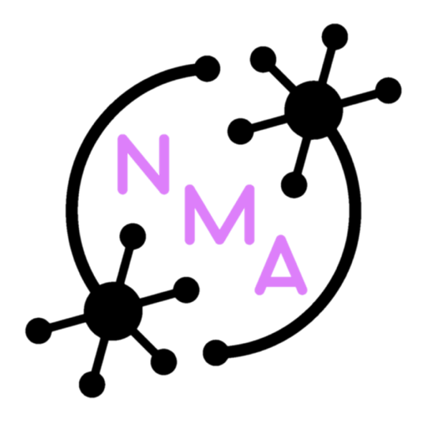
1800+ Interactive students
190+ teaching assistants
220+ faculty & industry mentors
6000+ Observer students
120+ NMA organizers
the Neuromatch Academy community
our typical communities
our wider communities
diversity
inclusion
cooperation
advocacy

Slide 20
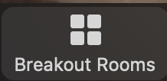
Activity [5-10 min]: who’s in the room?
Get into your breakout groups (megapods) and introduce yourself:
Your name
Your career stage
Your current institution or place of work
3 words that characterize your research or professional interests
For example: Kate Bonnen, Postdoctoral Fellow, New York University, [visual perception, walking]
Notes:
Let’s take a moment to get to know who’s in the room:
I’ll give everyone a moment to scroll through the chat and read people’s intros.

Slide 21
Questions?

Slide 22
BREAK

Slide 23
TA training --
Learning Principles

Slide 24
Learning process
Learning is iterative!
There is no one-shot learning!
Depending on their starting point, students will learn different things
Everyone will get something else out of NMA → And that’s ok!!!
A beginner will not magically become an expert…
Explore Content and Concepts
Learning
Loop
Reflect or Resolve
Pique Interest
Integrate New Knowledge

Slide 25
Learning process
Spectrum of learners...
Novice
Competent Practitioner
Expert
Notes:
In the learning process in any domain we’re all somewhere along this spectrum on a journey from novice to expert … And this includes us as TAs
One good way to think about is this is in terms of mental models
A mental model is a collection of concepts and facts that a person knows about a topic, along with the relationships between those concepts. For example, I made a peanut butter jelly sandwich for lunch for most of my childhood.
We can distinguish between a novice and a competent practitioner for a given domain based on the complexity of their mental models.
Source credit: https://carpentries.github.io/instructor-training/02-practice-learning/index.html

Slide 26
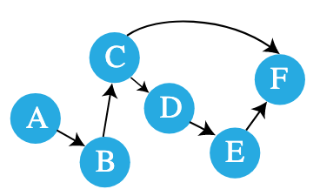
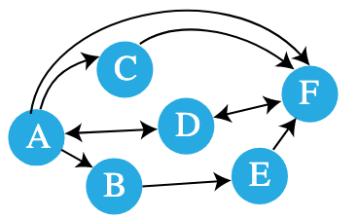
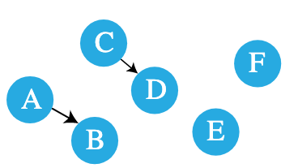
Learning process -- Mental Models
Spectrum of learners have different mental models
Novice
Competent Practitioner
Expert
Notes:
A novice is someone who has not yet built a mental model of the domain. They therefore reason by analogy and guesswork, borrowing bits and pieces of their mental models of other domains which seem superficially similar.
A competent practitioner is someone who has a mental model that’s good enough for everyday purposes. This model does not have to be completely accurate in order to be useful: for example, the average driver’s mental model of how a car works probably doesn’t include most of the complexities that a mechanical engineer would be concerned with.
Expert: Experts mental model is flexible, nuanced and has many connections. They: a) see connections between two topics or ideas that no one else can see; b) can see a single problem in several different ways; c) know how to solve a problem, or “what questions to ask”; d) jump directly from a problem to its solution because there is a direct link between the two in their mind. Where a competent practitioner would have to reason “A therefore B therefore C therefore D therefore E”, the expert can go from A to E in a single step (“A therefore E”).
Source credit: https://carpentries.github.io/instructor-training/02-practice-learning/index.html

Slide 27
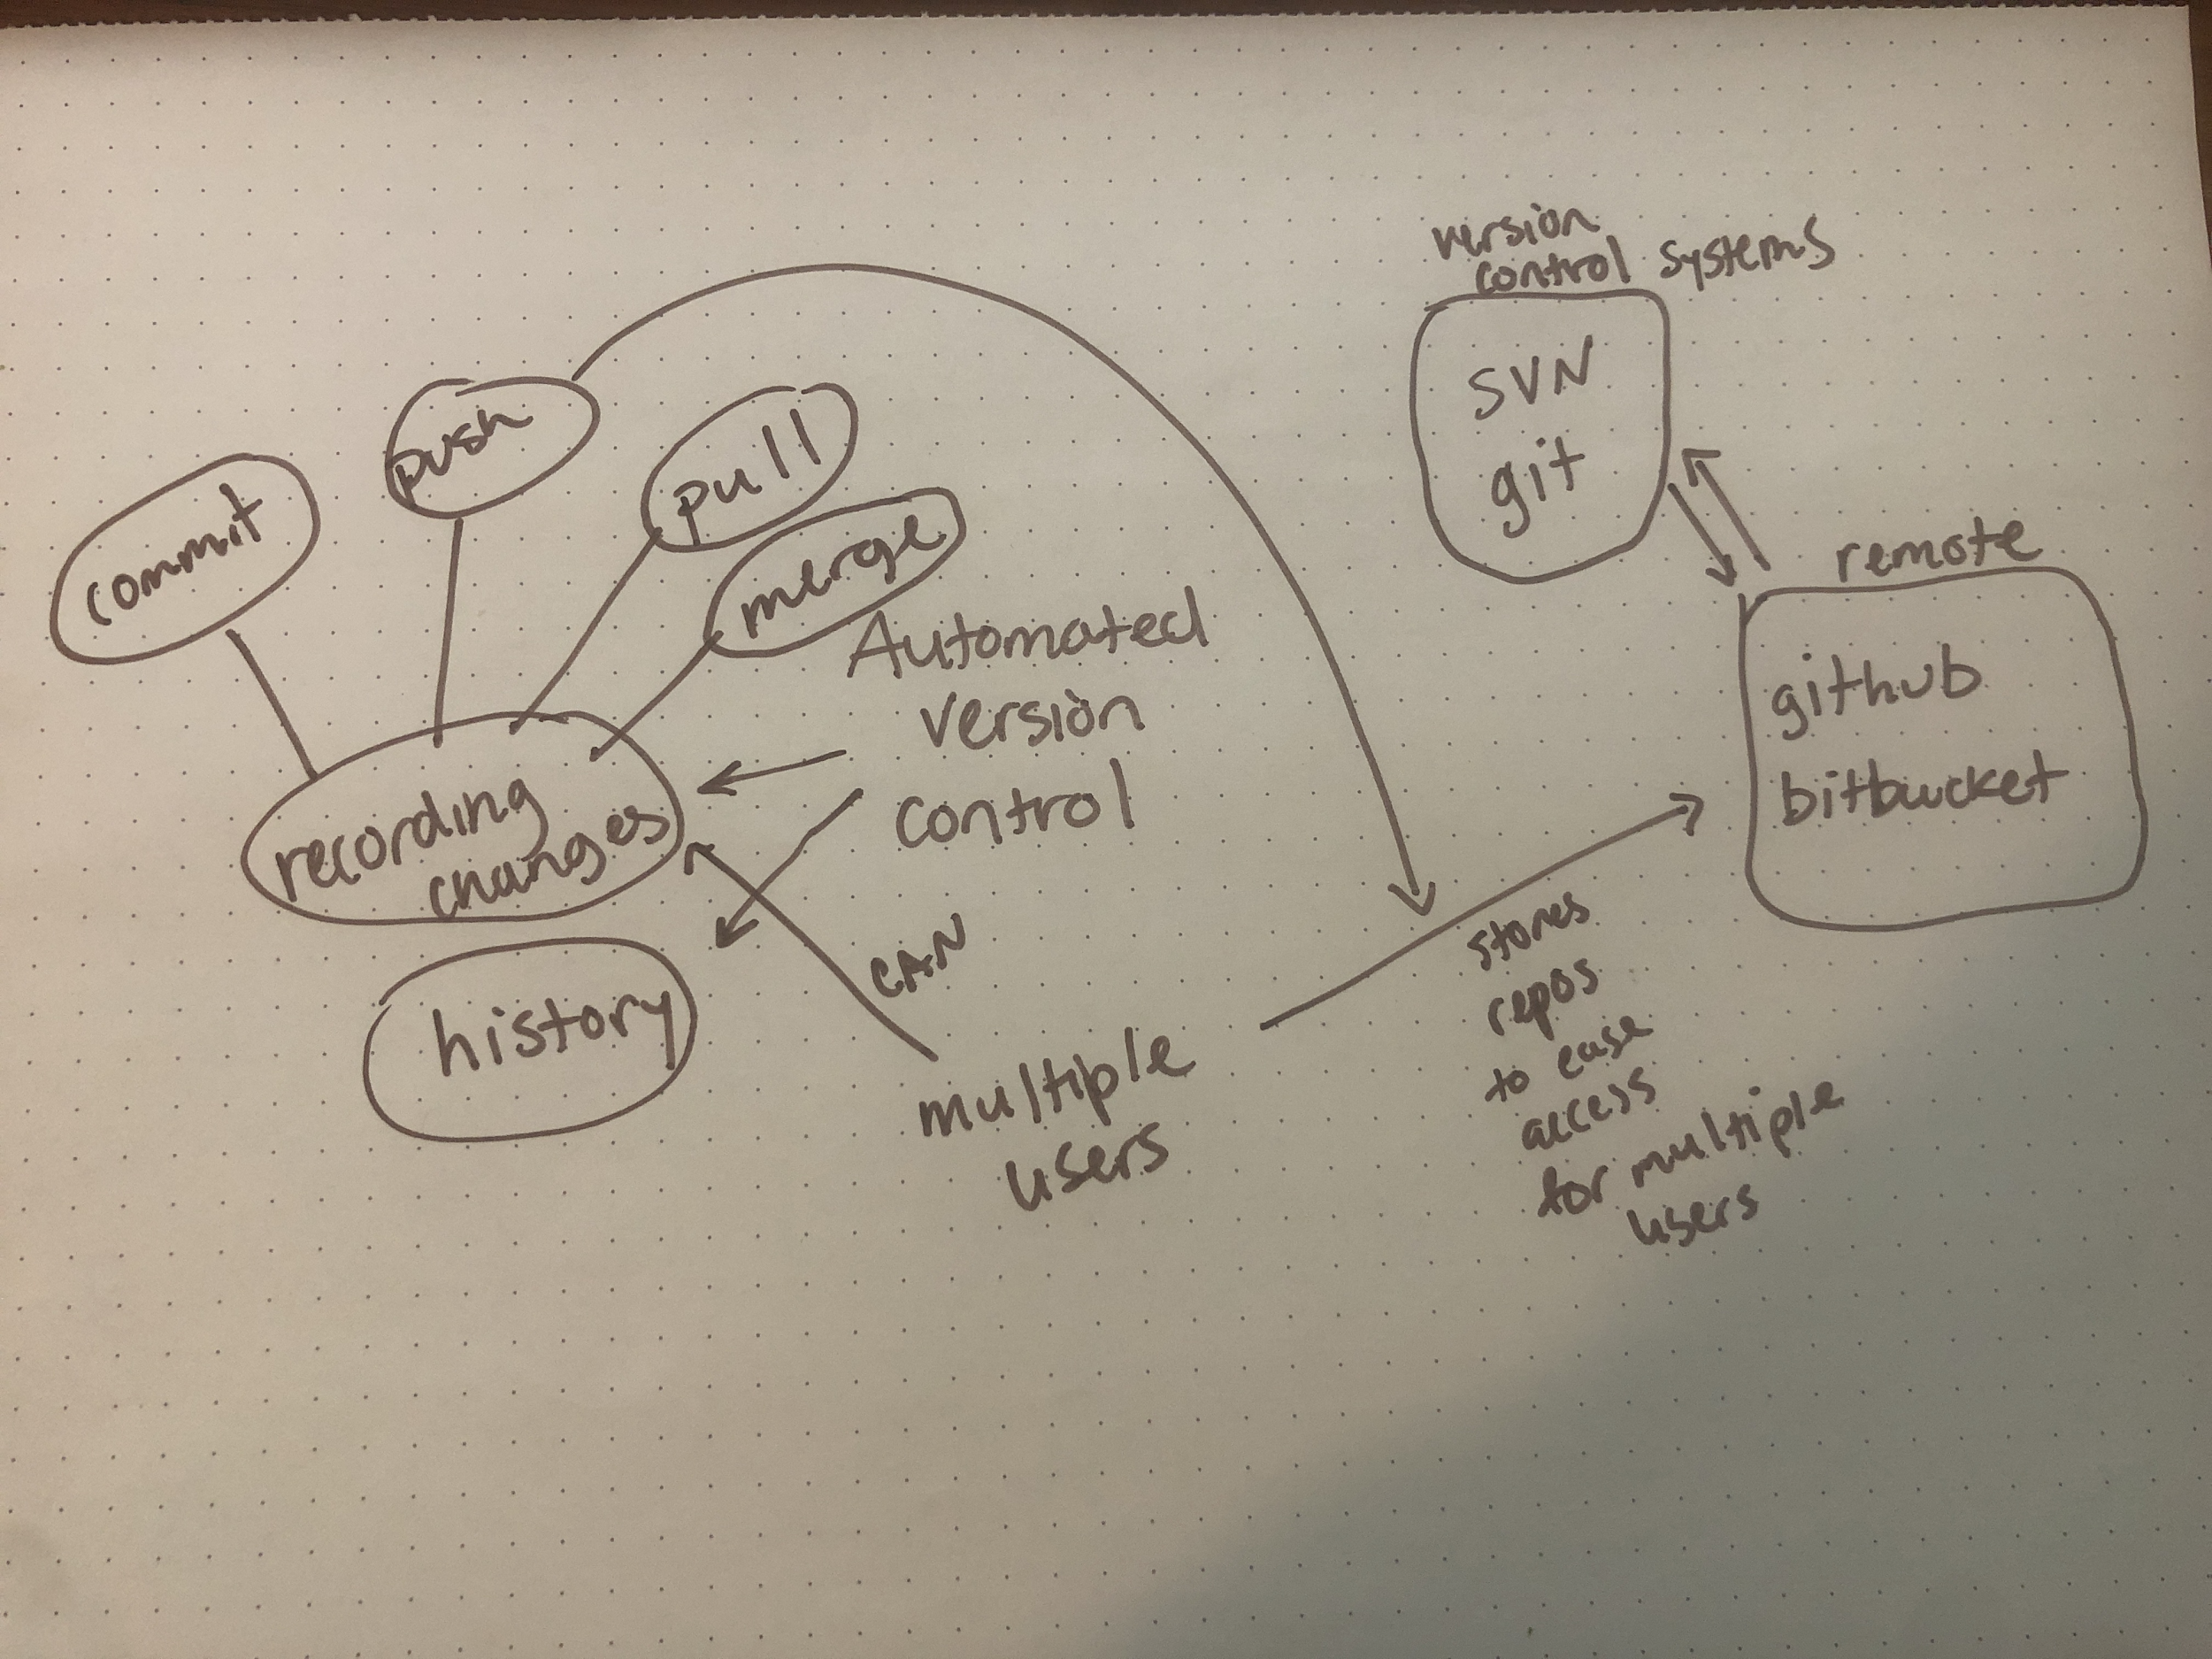
Learning process -- Mental Models
Activity [5 min]: Choose a topic (e.g., your area of research, the last project you worked on, a skill or a hobby). Draw part of your mental model for this topic. Make sure you include some concepts and facts as well as the relationships between them. E.g. (version control) → https://carpentries.github.io/instructor-training/02-practice-learning/index.html
Notes:
One or two people willing to share their mental model?
As you might imagine: novices, competent practitioners, and experts have different needs in the learning process. So if you are an expert in a topic, you may find that your way of thinking about a set of problems is inaccessible to your students. Conversely, as a teacher there can be some advantages to being closer to your students along this knowledge acquisition axis (maybe you’re more of a competent practitioner than an expert on a topic).
Many of your students will be novices in at least some of the topics we cover during the course. Thus they may not have a strong mental model of the concepts we cover. One way to think about your role is that you are assisting your students in constructing a working mental model so that they have something to build on in the future. In other words, our goal is to teach people how to think about neural modeling and computational neuroscience in a way that will allow them to continue to learn after the course.
So how do we help learners progress?
Source credit: https://carpentries.github.io/instructor-training/02-practice-learning/index.html

Slide 28
So where do you (as a TA) fit in?
Notes:
So where do you as a TA fit in to helping students to build and grow their mental models regardless of where they are along the learning process?

Slide 29
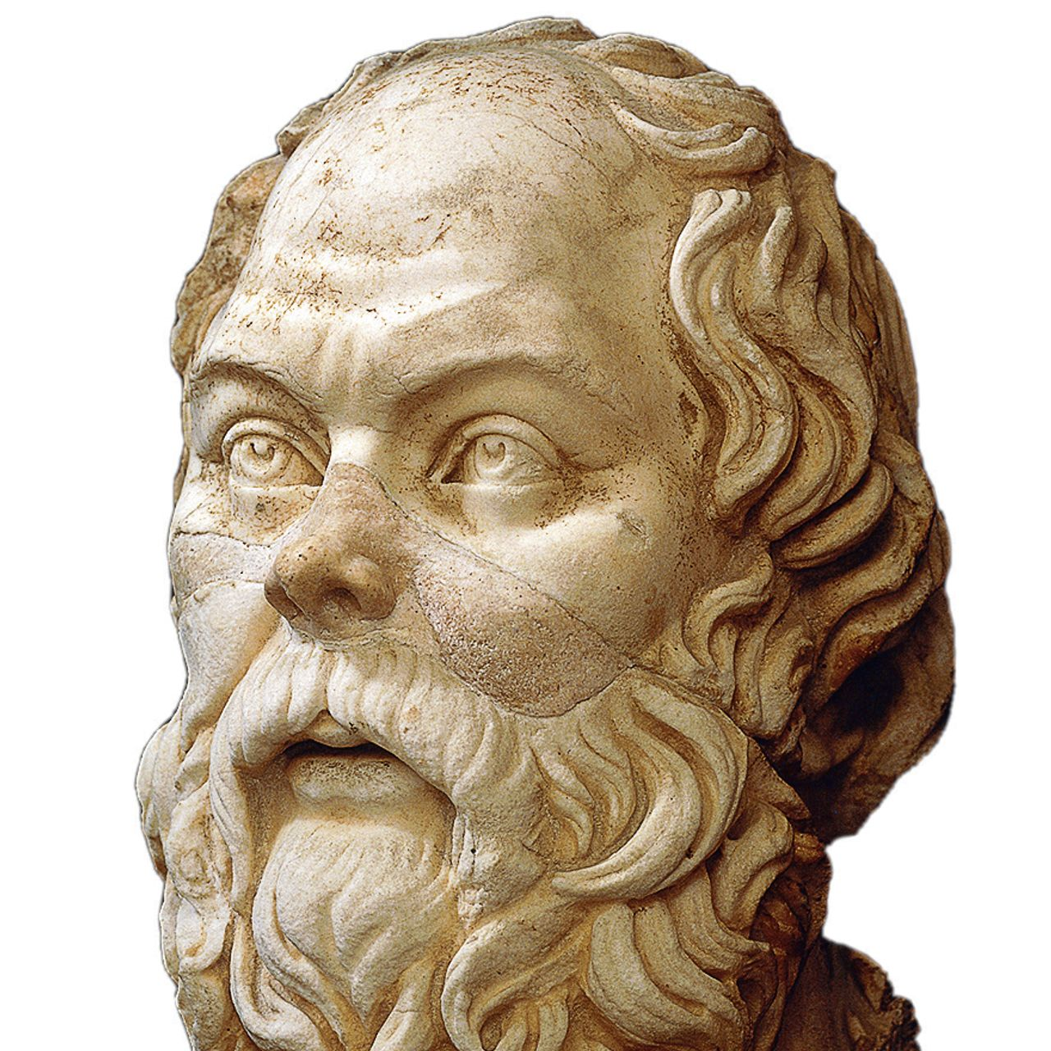
TA -- Guide, Facilitator, Tutor
“I cannot teach anybody anything. I can only make them think” - Socrates
As a TA, you are NOT (necessarily) an expert in all the course materials and that’s ok!
Your role is to redirect student questions to allow them to find answers themselves!
Encourage small groups to discuss problem / questions before asking the TA!
Notes:
Maybe this actually goes with TA roles and responsibilities?

Slide 30

TA -- Guide, Facilitator, Tutor
Use principle of “guided discovery”
Find a balance between:
Allowing students to learn from their mistakes
Avoiding letting them get lost / totally frustrated by lack of progress
Students are responsible for their own learning experience!
Encourage students to explain their reasoning and thinking
E.g. by stimulating self‐generated explanations of concepts
When a student is stuck, encourage them to explain why and to be more specific about what is happening.

Slide 31
TA -- Example Questions
Activity [10 minutes]: In breakout groups work through the following 3 example questions. Read each one aloud and determine both which is the best TA answer and why, identifying what is problematic about the other answers.

Slide 32
TA -- Example Questions
Example 1 - Student Q: “I don’t understand what to do”
What’s the best TA answer?
“You do [insert correct answer]”
“What exactly don’t you understand?”
“You should have listened to the lecture!”

Slide 33
TA -- Example Questions
Example 1 - Student Q: “I don’t understand what to do”
What’s the best TA answer?
“You do [insert correct answer]”
“What exactly don’t you understand?”
“You should have listened to the lecture!”
→ encourage students to articulate specifics!

Slide 34
TA -- Example Questions
Example 2 - Student Q: “My code doesn’t work...”
What’s the best TA answer?
“Why do you think that is?”
“That’s a silly mistake!”
“You forgot to do [something]”

Slide 35
TA -- Example Questions
Example 2 - Student Q: “My code doesn’t work...”
What’s the best TA answer?
“Why do you think that is?”
“That’s a silly mistake!”
“You forgot to do [something]”
→ encourage students to think for themselves to find their errors

Slide 36
TA -- Example Questions
Example 3 - Student Q: “I can’t do this...”
What’s the best TA answer?
“Yeah… this is not for everyone!”
“Of course you can, where are you stuck?”
“Ok, just wait this one out...”

Slide 37
TA -- Example Questions
Example 3 - Student Q: “I can’t do this...”
What’s the best TA answer?
“Yeah… this is not for everyone!”
“Of course you can, where are you stuck?”
“Ok, just wait this one out...”
→ be encouraging and positive!

Slide 38
BREAK

Slide 39
TA training --
Misconceptions and Motivational Language

Slide 40
Misconceptions
Misconceptions are gaps in knowledge
Education researchers put these gaps into three categories:
Simple factual errors
Broken models
Fundamental beliefs
Notes:
A Misconception

Slide 41
Misconceptions -- Gaps in knowledge
Simple factual errors
e.g., believing that Vancouver is the capital of British Columbia. [It’s Victoria]
These are the easiest to correct.
Broken models
e.g., believing that motion and acceleration must be in the same direction.
Address these by having learners reason through examples to see contradictions.
Fundamental beliefs
e.g., “the world is only a few thousand years old”.
These beliefs are deeply connected to the learner’s social identity.
Notes:
A Misconception

Slide 42
Identifying misconceptions
As a TA part of your role will be to identify misconceptions and help students to resolve them.
Formative assessments - a diagnostic tool to monitor student learning [usually low stakes]
vs.
Summative assessments - a tool to evaluate student learning, to measure how much someone has learned [often high stakes; tests, term papers, etc].
Notes:
Think about how the wrong answers are chosen. Notice that each one tells you something about what misconception the student has.
Handling outcomes: Formative assessments allow us as instructors to adapt our instruction to our audience. What should we do as instructors if the class chooses:
mostly one of the wrong answers?
mostly the right answer?
an even spread among options?

Slide 43
Identifying misconceptions
Activity [5 min]: In your groups examine the following example formative assessment:
What is 27 + 15 ?
a) 42
b) 32
c) 312
d) 33
Explain the misconception identified by each wrong answer.
Discussion: Handling Outcomes? [3 min]
Notes:
Think about how the wrong answers are chosen. Notice that each one tells you something about what misconception the student has. Individually, determine what has gone wrong in each of the wrong answers. Lead TAs: Have someone explain each of the answer choices.
So if you were going to use this question in a class and have the students hold up a card to choose their answer, or use clickers, etc, how would you handle the outcomes?
Handling outcomes: Formative assessments allow us as instructors to adapt our instruction to our audience. What should we do as instructors if the class chooses:
mostly one of the wrong answers?
mostly the right answer?
an even spread among options?

Slide 44
Identifying misconceptions
Activity:
[7 min] Write your own multiple choice question for a topic of your choosing that helps you to identify misconceptions.
[5 min] Share your examples.
Note: While you likely won’t be writing multiple choice questions during the course, it is helpful to practice this skill because it helps you think through how to ask your students questions and what their answers tell you.
Notes:
Write your own multiple choice question for a topic of your choosing that helps you to identify misconceptions. While we won’t necessarily be asking you to do this during the course, it is helpful to practice because it will help you to think through how to ask your students questions as they are working through their confusion about various ideas.

Slide 45
Motivational Language

Slide 46
Activity [10 min]: In your groups, spend a few minutes think of an example of a class or an instructor that has successfully created a positive learning environment where you felt highly motivated. And then a second example of a class or an instructor where you were highly demotivated. What were the reasons why? Share with your group.
Notes:
Share in your small groups.

Slide 47
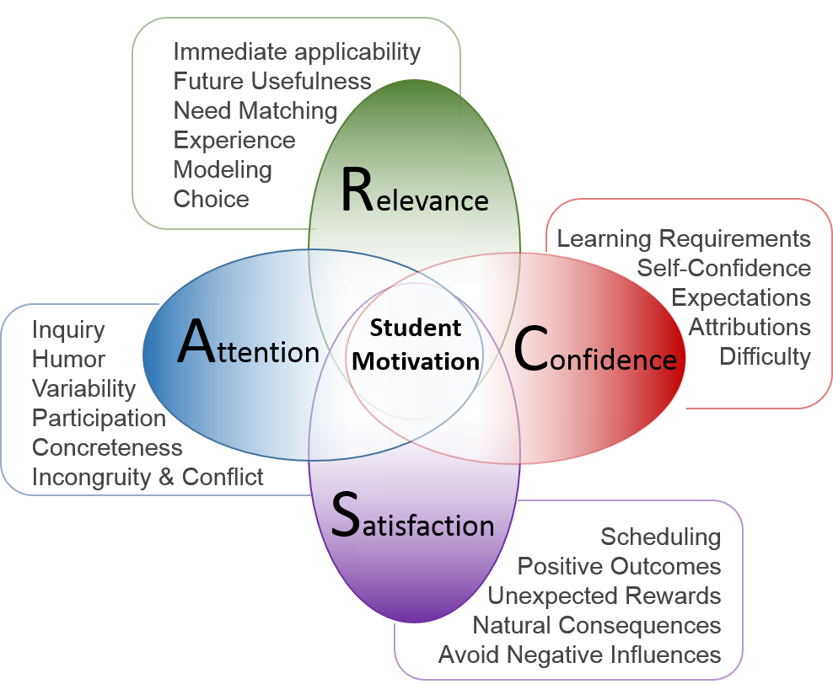
Motivation
This graphic shows a number of factors that contribute to student motivation in the classroom
Notes:
Here’s a list common things that contribute to student motivation

Slide 48

Creating the right environment
Motivation and positive environments are key to learning!
Be humble: make it clear you’re not an expert
Encourage teamwork: students can learn from each other!
Curiosity is key: “there are no dumb questions”
Be positive: encouragements, compliments, etc
“Congrats! You did it!” | “Awesome!” | “You can do it!”
Be inclusive: make sure everyone is treated equally!
Be mindful of the “shy” people...

Slide 49

Creating the right environment
Active learning >> passive learning
Errors are not mistakes but opportunities for deeper learning!
Learning in a group >> individual learning
Learning is an iterative process
Every student will get something else out of NMA!
It’s better to go slowly through parts than to rush through everything!
Prior misconceptions take longer to overcome...

Slide 50
Motivation - Don’ts:
Use the J word (“just”) or other demotivating words. These signal to the learner that the instructor thinks their problem is trivial.
Pretend to know more than you do. People will actually trust you more if you are frank about the limitations of your knowledge, and will be more likely to ask questions and seek help.
Take over the learner’s keyboard. It is rarely a good idea to type anything for your learners. Doing so can be demotivating for the learner (as it implies you don’t think they can do it themselves or that you don’t want to wait for them).
Feign surprise. Saying things like “I can’t believe you don’t know X” or “You’ve never heard of Y?” signals to the learner that they do not have some required pre-knowledge of the material you are teaching, that they don’t belong at the workshop, and it may prevent them from asking questions in the future. (For more on this see the Recurse Center’s Social Rules).
Speak very negatively about any tool. Regardless of its shortcomings, many of your learners may be using that tool. Convincing someone to change their practices is much harder when they think you disdain them.
These examples come from a Western instructor training course. Please think carefully about your culture and your students’ culture as you consider what else might belong on this list.
https://carpentries.github.io/instructor-training/08-motivation/index.html

Slide 51
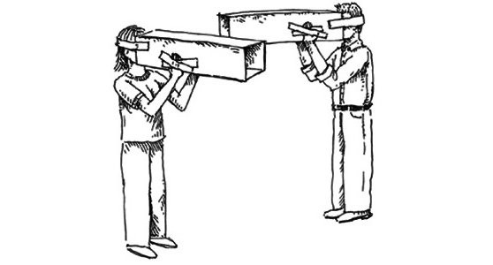
Motivation - mindfulness
Expert awareness gaps can lead to
demotivating language
Notes:
What are the ways we might (though we are all well-intentioned) fall into demotivating language and create negative moments.
Experts are frequently so familiar with their subject that they can no longer imagine what it’s like to not understand the world that way - this inability to consider the material from a non-expert perspective can lead to what’s known as the expertise-reversal effect - experts are often less good at teaching a subject to novices than people with less expertise who still remember what it’s like to have to learn the things. This effect can be overcome with training, but it’s part of the reason world-famous researchers are often poor lecturers.
Experts often betray their extensive knowledge by using the word “just” in explanations, as in, “Oh, it’s easy, you just fire up a new virtual machine and then you just install these four patches to Ubuntu and then you just re-write your entire program in a pure functional style—no problem.” This gives learners the very clear signal that the instructor thinks their problem is trivial and that they therefore must be stupid.
With practice, we can change the way we speak to avoid this type of demotivating language and replace it with more positive and motivating word choices.
Experts do have advantages: because of their well-connected knowledge, self-aware experts are well-poised to help students make meaningful connections among their knowledge, to confidently turn an error into a learning opportunity, or to explain a complex topic in multiple ways. The important thing is to identify awareness gaps and to try to see things from the learner’s perspective as much as possible.

Slide 52
Motivation - Say it differently [optional]
Activity [7 min]: In your breakout groups, think of examples of demotivating language that you may have heard (or used) in the classroom before? What might you say instead?
Notes:
Have everyone brainstorm something and write it down. Invite people to share out loud.

Slide 53
BREAK

Slide 54
TA training -- Giving
and Receiving Feedback

Slide 55
http://www.lunarbaboon.com/comics/feedback.html
Notes:
GO TO THE LINK!!! It’s a comic about giving and receiving feedback.

Slide 56
Giving and receiving feedback
Summary of the comic: What you say and how you say it matters
Be positive
Be specific
Give a next step
Giving feedback to your students
Receiving feedback from your students (and fellow TAs)
Notes:
Here we’re going to talk a bit about giving and receiving feedback

Slide 57
Daily Feedback Forms
Formative assessment for you as a teacher
https://datacarpentry.org/blog/2017/06/minute-cards
Daily anonymous feedback from students:
Did you enjoy the content on this day? [1-5]
Was it too easy (1), just right (3), or too hard (5)?
What's the most important thing that you learned today?
Is there anything that you're confused about and would like clarification on?
What are we doing well? What do you think we could be doing better?

Slide 58
Feedback Procedure
Students will fill them out each day before the outro/Q&A if possible.
Their responses will be anonymous
Remind them to do this
Read the new feedback responses before the next day’s tutorials begin and try to use that information to help students learn / improve the classroom environment.
If students confide code of conduct violations, they must be reported immediately.
Now for some logistics about how this will work...

Slide 59
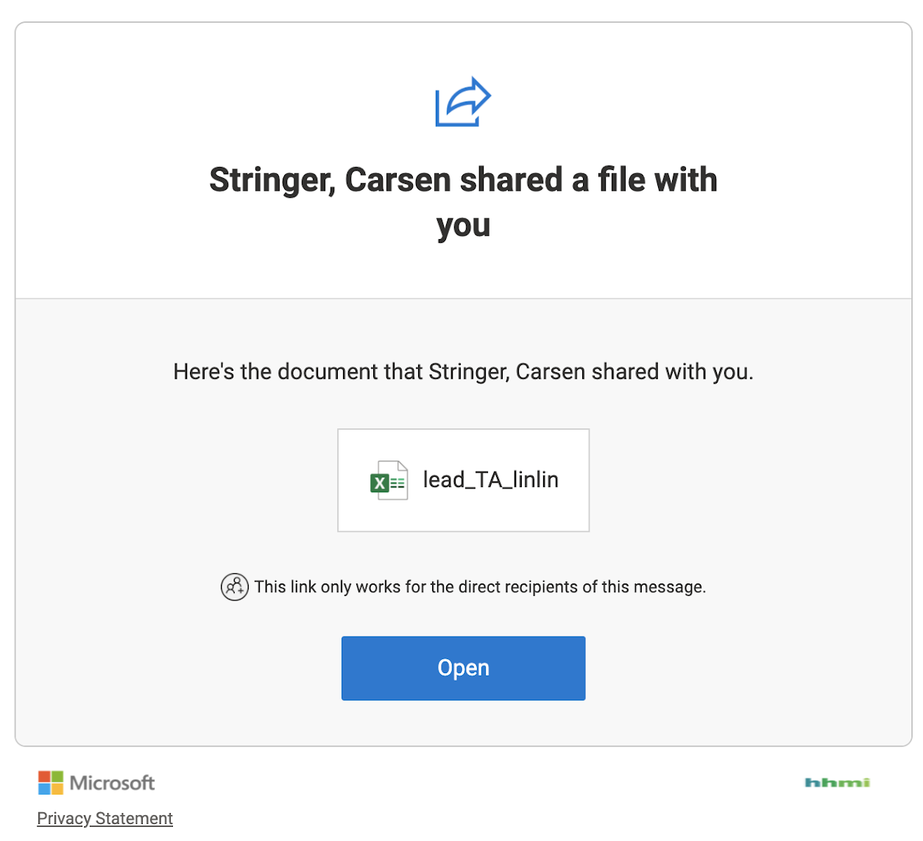
Feedback Procedure -- Logistics
TA Training Team has created feedback forms for students to fill out.
You will provide the Form link to your students to fill out at the end of each day
All TAs in your megapod will be using the same feedback form [students will specify their TA]
You will receive an invitation to view your megapod’s feedback form responses.

Slide 60
Feedback Procedure -- Logistics
TA Training Team has created feedback forms for students to fill out.
You will provide the Form link to your students to fill out at the end of each day
You will receive an invitation to view your megapod’s feedback form responses.
When you click open the first time it will ask you to verify your email.
This verification email will probably go to your spam folder. You will need to retrieve it.
Once you have access there are a couple of things you should know

Slide 61
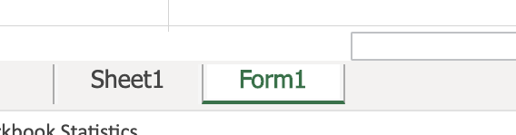
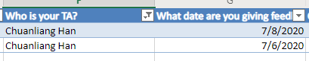
Feedback Procedure -- Logistics
The Form responses may not be in “Sheet 1” Look at the tabs below for the one labelled “Form1”
You will not have edit capabilities but you will be able to view and sort the form which means you should be able to easily find your feedback for the most recent day of class.
The category names have arrows next to them that allow you to sort/filter.
Sort by “What date are you giving feedback for” to see feedback for that day
Filter the column : “Who is your TA?” with by your name.

Slide 62
Questions/Concerns about the Feedback procedure?

Slide 63
Precourse Responsibilities

Slide 64
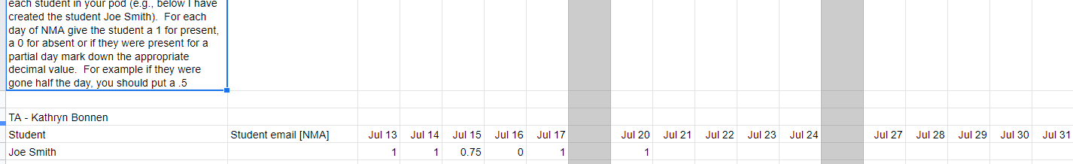
Getting Ready for the first day
Prep your tech stack! → see technical
Review the tutorials
Ask questions on neurostars if you have them
Check out the TA Guide: https://docs.google.com/document/d/1HVFSluDROJU7gDRD6HBnJDbSs4VlgwLx_f54ykPXar8/edit
Make your attendance sheet and provide your lead TA with the link
e.g.: https://docs.google.com/spreadsheets/d/1m5bGlndm7CnKy0q2b8ejhxTWfC_s94uV_TJrZAYTe04/edit#gid=0
Could be with Google Sheets or OneDrive as long as your lead TA can access

Slide 65
Getting Ready for the first day
Make sure you have access to the Feedback link from your lead TA before the end of the week.
Organize your neurostars pod-specific category.
In a pinned post please introduce yourself and provide the schedule info (as computed here: https://colab.research.google.com/drive/1IfyXSrOwWtkEu5o9PYVwY6zbQ_9PGd8g).
See an example in the “Technical Stack in practice slides” for Day 2 of training
In a separate post, provide a link [zoom or dingtalk] to join your room the first day

Slide 66
Getting Ready for the first day
Contact your pod via email [ASAP]
Get your students onto neurostars
Arrange to meet during the keynote timeslot on the first day.
Your students will need to watch the keynote earlier or the night before.
During that time have everyone introduce themselves and tell a little bit about their research interests. We also suggest doing an icebreaker:
https://www.mindsettlers.com/guide/42xoXdAepG4S4U8SiaA6Ii
An icebreaker with drawing ensures students have pen and paper (notebook!) too for going through tutorials :)

Slide 67
Python Workshop Responsibilities

Slide 68
Pre-course Python Workshop
What is the pre-course python workshop?
~400 students will join us Thu/Fri to work a set of introductory python notebooks.
Github location
It will be here: https://github.com/NeuromatchAcademy/course-content/tree/master/tutorials
If you want to see it now (7/6/20) as it is developed you can find it in the W0D1_python_workshop_draft branch on github: https://github.com/NeuromatchAcademy/course-content/tree/W0D1_python_workshop_draft/tutorials
The notebooks are in the same format as the rest of the NMA notebooks
There will be nano-lectures followed by exercises.
Except that more lines of code are often required since the focus is programming.

Slide 69
Pre-course Python Workshop
Why have a pre-course python workshop?
Give students an interactive way to refresh or ramp-up their python skills
We hope this will make the first week go more smoothly
Give TAs a chance to get a feel for what teaching at NMA will be like and have the weekend to reflect.

Slide 70
Pre-course Python Workshop
What are your responsibilities?
Review the material ahead of time.
Your superpod will be responsible for guiding your students
There may be exceptions to this because we allowed students to select the time slot they wished to attend.
Have your python workshop students fill out the feedback form before they leave each day.

Slide 71
TA training -- Q&A

Slide 72
Further readings (recommended!)
Code in place “outstanding teachers” guide
Carpentries instructor training
De Grave, Dolmans, Van Der Vleuten (2002). “Profiles of effective tutors in problem‐based learning: scaffolding student learning”

Slide 73
TA training -- End of Day 1

Slide 74
TA training -- Tech Stack

Slide 75

Technical
& tutorials training

Slide 76
Github
The course content will be in
https://github.com/NeuromatchAcademy/course-content
We have a subdirectory (tutorials) with a README.md linking to YouTube videos and colabs, with badges (that allow you to open them in colab).

Slide 77
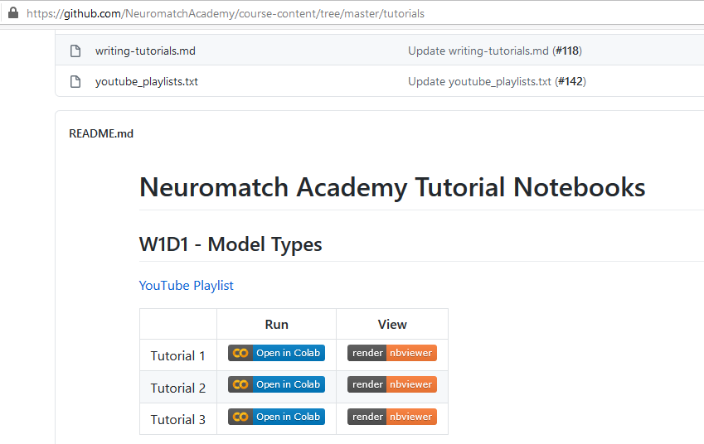
Github
Student version

Slide 78
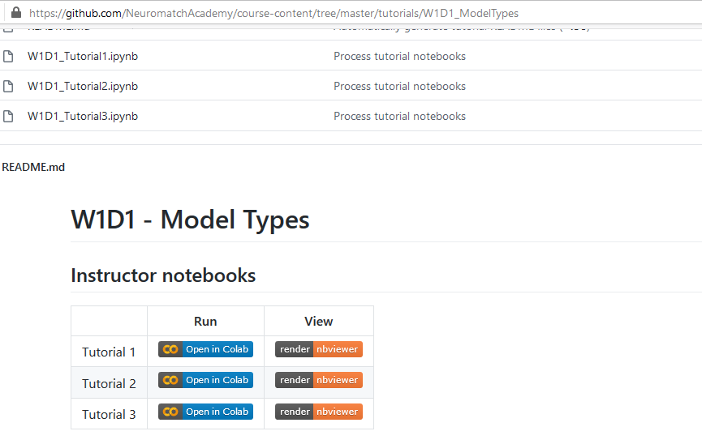
Github
Instructor version with
solutions inside of day folder

Slide 79
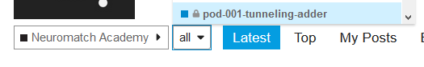
Neurostars - a forum
Neurostars is a neuroscience forum
We are the Neuromatch academy category
Use discourse to talk to your students and direct them to ask and answer questions
You will have your own private subcategory for your pod. You should have received your pod name in your email.
Your private category is a safe place to leave a zoom link

Slide 80
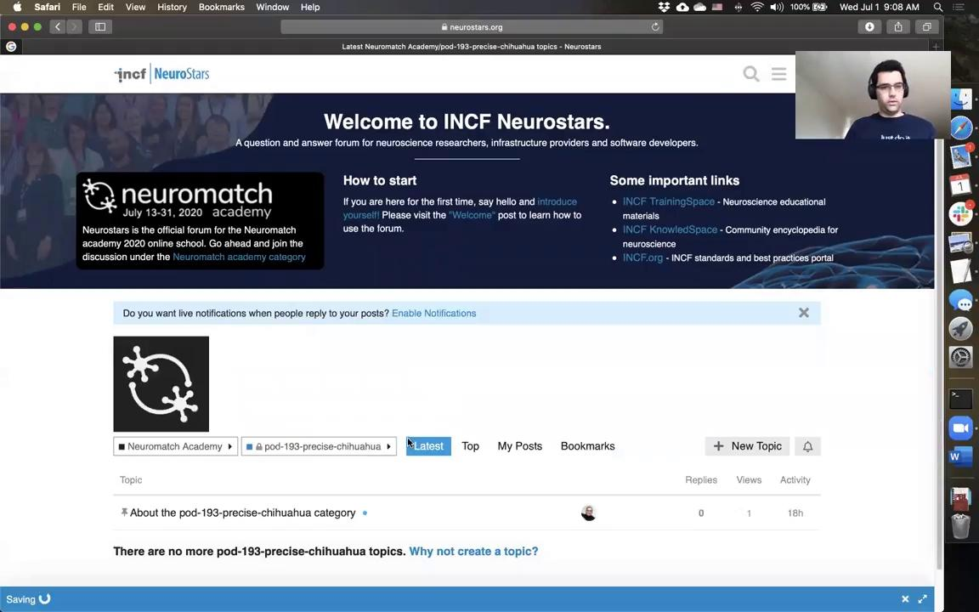
Neurostars -
A practical introduction
[Live Demo -- Video coming soon]

Slide 81
Zoom
Get Zoom Pro
If you indicated you need a zoom pro account, we will give you one
We are rolling these out starting July 2nd; your account will be valid until July 31st.

Slide 82
Zoom
You are responsible for scheduling the meeting and sending the invite
Go into zoom.us, login, create an invite, send it out to your students ( you have all their email addresses). Post it on your neurostars category as an announcement.
Your students will be in different timezones, don’t try to calculate time zones in your head - send a calendar invite [ASAP].

Slide 83
AV setup
Take 10 minutes to optimize your microphone.
Zoom has noise and echo cancellation - do your testing outside of zoom so it’s easier to optimize raw audio quality.
Go to https://webcamera.io/. Select a microphone. Record a test sequence
Say this sentence: Oak is strong and also gives shade.
Say this sentence while simultaneously typing it out: Cats and dogs each hate the other.
Listen to the audio.
Repeat this for all the microphones you have in the house (e.g. built-in laptop microphones, iPhone earbuds, wireless headphones, earbuds, etc.) to find out which works best.
Things to watch out for:
Loud keyboards. You’ll be writing live code, it will sound like a hammer if the microphone is close.
Low volume. Consider different mic placement.
Tinny sound. Bluetooth often has this problem.
Fan noises on gaming laptops.

Slide 84
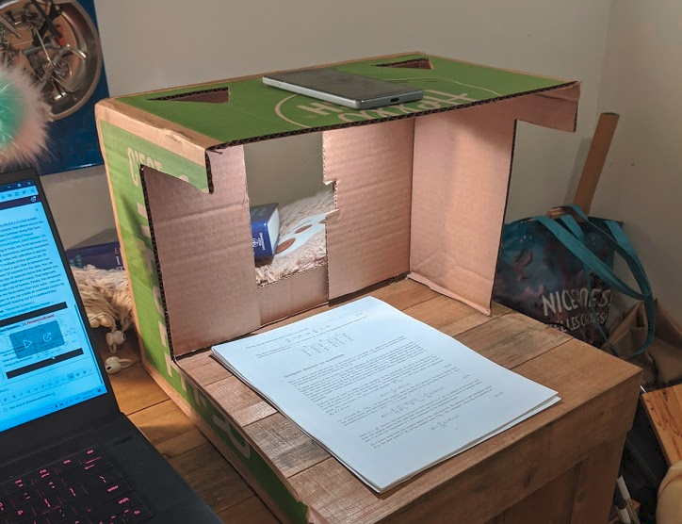
Zoom - AV setup
Your webcam doesn’t matter as much as the microphone, however, eye contact is still important. Use a camera at eye level rather a low-placed “nostril cam”; you will look more expressive and empathetic
Try to optimize lighting by having lights primarily in front of you rather than in the back.
You can join your zoom meeting with a secondary smartphone to grab an overhead view of paper notes, or do a real-life whiteboard. Please use landscape mode.
An overhead projector via a smartphone

Slide 85
Basic Zoom security
Don’t post zoom links on social media (Twitter, Facebook, YouTube)
Bots will harvest the links and zoombomb you
Posting on our private discourse is fine

Slide 86
Classrooms online
The first day:
Start with an icebreaker where you go around the room. Example icebreaker: First Name, why are you excited about the class, if you could have any superpower, which would it be? This will allow you to test all the student’s mics are working correctly.
Note: You will have to name students to ask them to introduce themselves because everyone’s tiles are in different orders
Students should mute themselves by default and unmute to speak in the larger room.
In breakout rooms it’s probably ok to be unmuted
Do tell them about all the tools you plan to use before you use them.
Not every student will have used these tools before.
Notes:
Example from microfinance: https://epod.cid.harvard.edu/sites/default/files/2018-02/the_economic_returns_to_social_interaction-_experimental_evidence_from_microfinance.pdf

Slide 87
Classrooms online
Your students bonding together will be crucial to their success.
Maybe the real learning will be the friends they make along the way :)
You can facilitate that.
Also, you may have people who disrupt other students in the class.
You will need to manage that, but know that you’re not alone.
Feel free to reach out to other TAs, your lead TA
Lead TAs are able to reach out to organizers
Notes:
Example from microfinance: https://epod.cid.harvard.edu/sites/default/files/2018-02/the_economic_returns_to_social_interaction-_experimental_evidence_from_microfinance.pdf

Slide 88
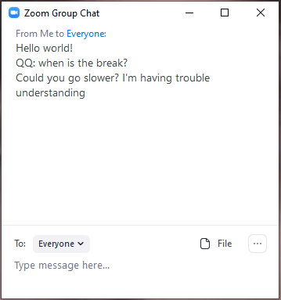
Zoom - Know the interactive tools
You can make your class more interactive with these tools:
Chat. In bigger rooms, chats can be quite active. Watch for questions. Make sure to mention the name of the person who asks you a question.

Slide 89
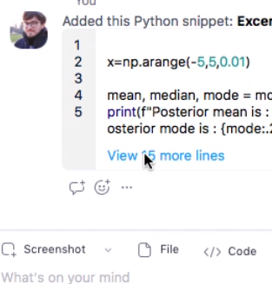
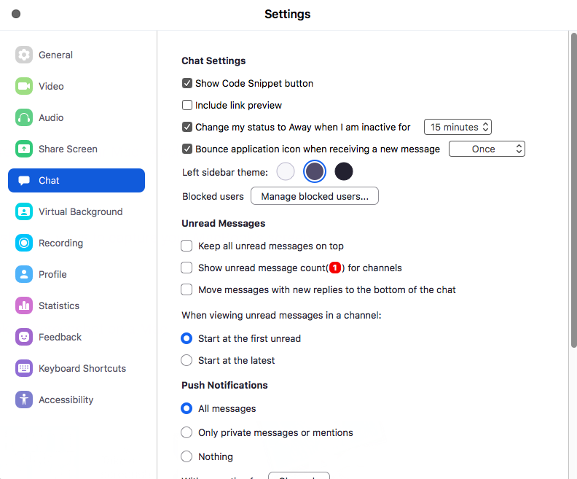
Zoom - enable Code Snippets

Slide 90
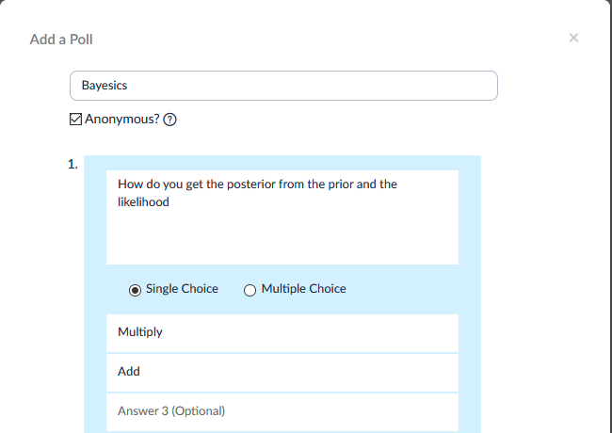
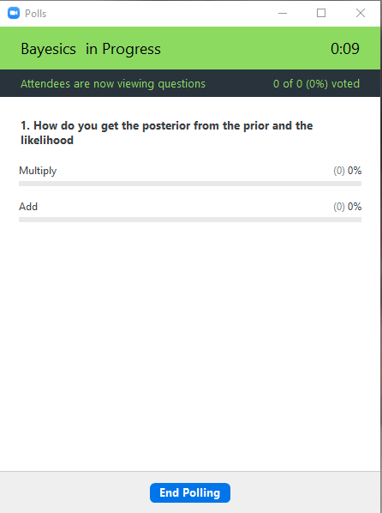

Zoom - Polls
Ask a question about comprehension. Gauge your audience.

Slide 91

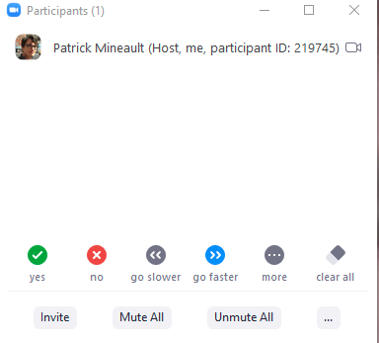

Zoom - Non-verbal feedback
By default, you only get clap and thumbs up reaccs. More reactions are available via the Participants panel. You cannot see the non verbal feedback when screen sharing.
Tip: in a pinch, you can test student comprehension by having them showing fingers: 1 finger I’m totally lost, 3: ok, 5: go faster, etc.

Slide 92
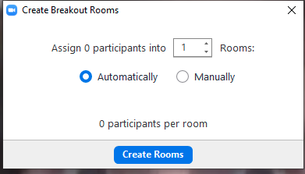
Zoom - Breakout rooms
Have your students discuss a topic in a smaller setting. For example: where do humans get their priors from (2 minute discussion). Bring your students back.

Slide 93
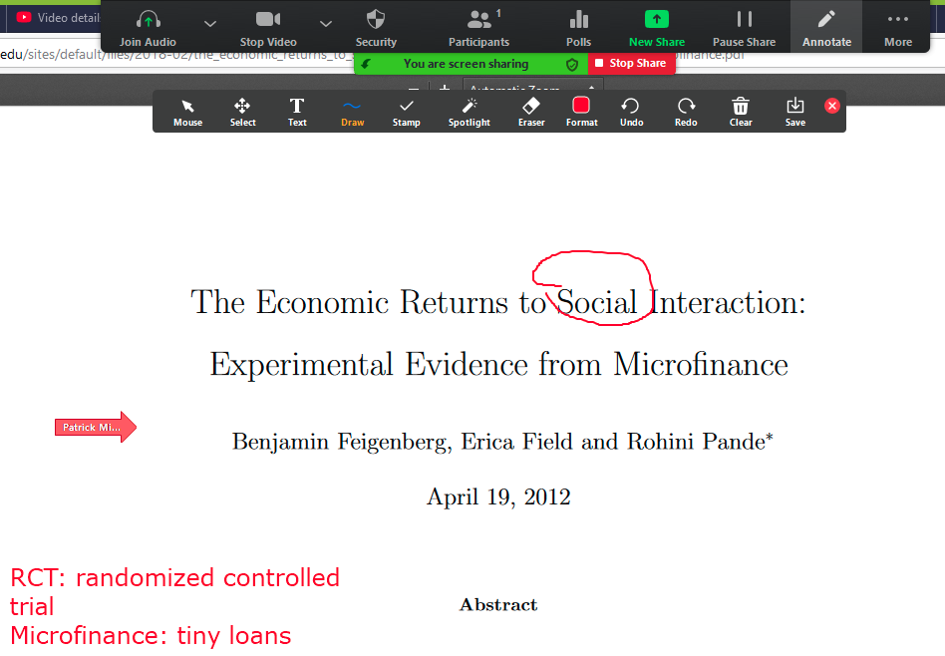
Zoom - Whiteboard
When in screen-sharing mode, you can draw over things (Annotate)
You can use this to annotate a graph, a video, write pseudo-code - the possibilities are endless.
You can have students collaborate on whiteboarding too.

Slide 94
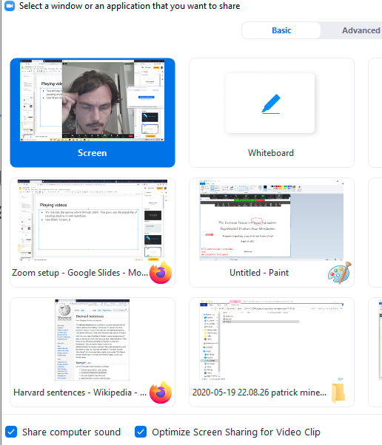
Zoom - Screen sharing
You can share your screen. It can feel a little invasive to share the whole screen, so consider sharing just a window, so people don’t end up reading your email.
When playing videos (in tutorials for example), hit Share computer sound.

Slide 95
Colab
You will need to tell your students to create a Google (gmail) account to get access to colab, if that’s not already done.

Slide 96
Colab
Colab is Google’s fork of ipython notebooks
Kernels live on Google’s servers, notebooks are stored on Google Drive, and are presented through the browser.
All the features of Drive: comments, versioning, etc. You can review a student’s
Annoyance: after an hour of inactivity, kernel shuts down from inactivity, killing any unsaved work.
Top right shows you kernel status: disconnected, connecting, running, idle, etc.
When you do something weird, Runtime > Restart and Run All.
If students bork their notebook, they can go back to Github for the original notebook

Slide 97
Colab
Open a notebook from Github, and hit File > Save a Copy in Drive to create a copy
To share between students, use Share > Share with Comments

Slide 98
Have fun!!!

Slide 99
TA training -- Leading Tutorials

Slide 100
Anatomy of a day of tutorials
https://colab.research.google.com/github/NeuromatchAcademy/course-content/blob/master/tutorials/W2D1_BayesianStatistics/W2D1_Tutorial1.ipynb
Intro lecture motivates topic
Tutorials provide hands-on learning in bite sizes
Short videos
Small hands-on exercise
Repeat!
Discussion allows in-pod consolidation
Outro + Q&A provide outlook
See big picture and ask questions about whole day...

Slide 101
How should students work together on tutorials?
Peer Programming: Two (or more) programmers working and/or learning together on the same computer / workstation
https://www.codefellows.org/blog/peer-programming-5-reasons-learning-in-a-group-beats-studying-on-your-own/
We are going to implement a slightly modified version of Peer Programming -- More on this in a minute…
What are the benefits of Peer Programming?

Slide 102
Peer Programming
Significant evidence to support peer programming in the
classroom and workplace.
It will jumpstart small group discussions and pod relationship building.
Key results from one study: https://collaboration.csc.ncsu.edu/laurie/Papers/XPSardinia.PDF
Many mistakes get caught as they are being typed
The designs are better and code length shorter (ongoing brainstorming); ·
The team solves problems faster;
The people learn significantly more, about the concepts and programming
the people learn to work together and talk more often together, giving better information flow and team dynamics;
people enjoy their work more.

Slide 103
How should students work together on tutorials?
GUIDE: https://docs.google.com/document/d/1znLhHKgC_TAia4vRTxQSV3-FV49W8ctBAT-Serex1Vc/edit?usp=sharing
Students work in breakout rooms with groups of 3-5 during tutorials.
Students: start work on an exercise section individually
Watch the necessary videos, read through the material get started on the programming exercise.
It’s about “giving it a go”, not about finishing it or understanding it completely.
During this individual period:
Direct students turn off their microphone and video.
Remind them of the caption options and the ability to change video speed
Turn their video back, leaving their mic off in order to signal that they are ready to work together again.

Slide 104
How should students work together on tutorials?
GUIDE: https://docs.google.com/document/d/1znLhHKgC_TAia4vRTxQSV3-FV49W8ctBAT-Serex1Vc/edit?usp=sharing
Once the “peer programming” stage begins, someone shares their screen (rotate this role each exercise) and the students and the TA, start working together on the exercise and through that process will probably talk about some of the following:
… the science…
What aspect of the course is being covered by this exercise?
What do we understand about it?
Does anyone have something to contribute to this understanding?

Slide 105
How should students work together on tutorials?
GUIDE: https://docs.google.com/document/d/1znLhHKgC_TAia4vRTxQSV3-FV49W8ctBAT-Serex1Vc/edit?usp=sharing
Once the “peer programming” stage begins, someone shares their screen (rotate this role each exercise) and the students and the TA, start working together on the exercise and through that process will probably talk about some of the following:
...the actual code…
Were there any misunderstandings? Are we stuck on something?
If the group is mostly not done, we work together to solve the exercise.
If someone wasn't able to do it, can we help them understand/complete it?

Slide 106
How should students work together on tutorials?
GUIDE: https://docs.google.com/document/d/1znLhHKgC_TAia4vRTxQSV3-FV49W8ctBAT-Serex1Vc/edit?usp=sharing
Once the “peer programming” stage begins, someone shares their screen (rotate this role each exercise) and the students and the TA, start working together on the exercise and through that process will probably talk about some of the following:
...and the outputs too…
How do we interpret the results?
What are the results showing us about the subject?
Do they help us understand the material better?
This step may take more time for harder exercises or for more interesting discussions. This is perfectly fine.

Slide 107
How should students work together on tutorials?
GUIDE: https://docs.google.com/document/d/1znLhHKgC_TAia4vRTxQSV3-FV49W8ctBAT-Serex1Vc/edit?usp=sharing
Move to the next exercise section and repeat this process from step 2.

Slide 108
Some Disadvantages and things to look out for
This really requires that students be willing and feel empowered to ask questions when they don’t understand or are stuck.
If students are struggling and don’t ask questions, the group will become asynchronous because at the end of the discussion that student will still not have finished the exercise.
Other students may feel guilty about this
It is absolutely critical that those with questions feel empowered to ask them; they are not slowing the discussion, they are adding to it.

Slide 109
Managing Group work
It’s an important part of the TA’s role to manage group time so that exercises are discussed synchronously
Some students may advance at a faster pace, this is ok.
They should always come back to the previous ones for group discussion.
Encourage everyone to speak, ask questions and share their answers
Discussing wrong solutions is also valuable and can help everyone to learn.
Can be a fruitful experience both for the student receiving feedback and for the rest of the group.
Feedback should be provided respectfully and positively.

Slide 110
Timing is critical
Before the day starts, make a note of how long you expect the “individual period” to take for each exercise.
The length of the nano-video-lectures + the reading (135 words per minute is a conservative estimate) + time to get started on the exercise.
Try to balance it to leave enough time for the peer work.
This will be your guide.
You will then monitor and let the students know when they should have begun the “peer programming” part of the exercise section
They are always welcome to the peer work early

Slide 111
Managing Student Time
Students should focus on the main tutorial materials!
Tutorials might contain a lot of additional information
Links to papers
Additional exercises → only to be done if finished before time runs out
These are for reference and hopefully for future learning on their own time.
Don’t read Python package documentations unless explicitly indicated
Otherwise students will quickly run out of time!

Slide 112
What should I tell my students about all this?
Explain to the process for working together during your first meeting
During the keynote slot on the first day.
Make it very clear that this is just a basic structure, and that it can be adapted / changed based on group needs.
You might also provide the following slide in this slide deck as a cheat sheet for the “peer programming” stage.
Emphasize that they may not do every part of this for every exercise.

Slide 113
Peer Programming Stage Cheat Sheet
Once the “peer programming” stage begins, someone shares their screen (rotate this role each exercise) and the students and the TA, start working together on the exercise and through that process will probably talk about some of the following:
… the science…
What aspect of the course is being covered by this exercise?
What do we understand about it?
Does anyone have something to contribute to this understanding?
...the actual code…
Were there any misunderstandings? Are we stuck on something?
If the group is mostly not done, we work together to solve the exercise.
If someone wasn't able to do it, can we help them understand/complete it?
...and the outputs too…
How do we interpret the results?
What are the results showing us about the subject?
Do they help us understand the material better?

Slide 114
Some Final Practical Advice
Have students pause the notifications on their computer if they can. (Note that some may need to leave them on for personal/family reasons).
Have students share only one application (their browser) - this will allow them to retain privacy (we won’t see their notifications).
You are NOT allowed to create breakout rooms with only 2 students.

Slide 115
TA training --
Tech Stack in Practice
Notes:
This will be done by lead TAs on separate zoom calls. Lead TAs will need a checklist for each person to complete.

Slide 116
Tech Stack in Practice Checklist - Zoom
Everyone will take turns being the zoom host
Share your screen, sharing only a single application
Put the group into 2 breakout rooms
Broadcast a message to the breakout rooms
Before you leave the first breakout room, ask one of the participants to hit the ask for help button a minute or so after you’ve left.
Visit each of the breakout rooms.
Exchange a person between breakout rooms
Close the breakout rooms
Know how to re-open the same breakout rooms
More functionality you might want to know: https://support.zoom.us/hc/en-us/articles/201362603-Host-and-co-host-controls-in-a-meeting

Slide 117
Tech Stack in Practice Checklist - Dingtalk [CHINA]
Guide:https://docs.google.com/document/d/1lN5f1bzoXpFR6FUMRzJQz1kZlNO_5PxN2sFS3F-pvMI/edit
Spend some time becoming familiar with dingtalk’s different functions
Share your screen, sharing only a single application
Navigate between multiple meeting #s
Use the dingtalk whiteboard

Slide 118
Tech Stack in Practice Checklist - Neurostars
Make an introductory post on Neurostars
e.g.: Hi, This is the space that will be used for messages within our pod, to organize Zoom meetings for the tutorials, and for within-pod discussions. I’d encourage you to introduce yourself in 2-3 lines here, by replying to this message, that way we can start getting to know each other. Like this: I am a [#th year PhD student] in [AFFILIATION]. I am very much interested in the question of [TOPICS OF RESEARCH]. In my spare time I enjoy [HOBBIES]. Our pod name is [pod-###-name-name]. We are in time-slot [123-ABC]. The 1st tutorial session in our pod will be from [00:00] to [00:00] UTC and the 2nd session will be from [00:00] to [00:00] UTC. You can use this link to see the timing of other events for our time-slot: https://colab.research.google.com/drive/1IfyXSrOwWtkEu5o9PYVwY6zbQ_9PGd8g Cheers!
Make a post with the Zoom (or Dingtalk [CHINA]) link for your pod.

Slide 119
TA training --
Leading Tutorials in Practice
Notes:
Lead TAs will need a checklist for people to complete during this segment. I think we have them practice being students / TAs

Slide 120
Leading Tutorials in Practice: Instructions
We want you to practice the peer programming model we described.
Your lead TA will choose a tutorial
Start working through the tutorial, beginning with the first exercise, like your students will.
Do this until it’s time to gather again.

Slide 121
TA training -- Q&A

Slide 122
TA training -- End of Day 2

Slide 123
TA training -- Group Projects

Slide 124
Group projects
Projects are largely self-directed, with a little guidance from TAs and mentors.
Groups will spend different amounts of time on projects, depending on experience and preferences. That’s okay.
It’s important to help the students feel like they are making progress — whatever progress they are making.

Slide 125
Group projects - coaching
Encourage students to actively think through how-to-model
guidelines: https://www.eneuro.org/content/7/1/ENEURO.0352-19.2019
Note: most important part of projects is to learn and apply the how-to-model concepts, NOT the exact project topic!
Organizers provide:
concrete project schedule to facilitate progress
Curated data sets and videos about them
Video of big picture of content that students will see in course
Video examples of two people brainstorming to find scientific questions

Slide 126
Group projects - coaching
Encourage students to actively think through how-to-model
guidelines: https://www.eneuro.org/content/7/1/ENEURO.0352-19.2019
TAs provide support (1-2h/day) → same Socratic method as tutorials…
Provide high-level guidance
Coding support
Encourage use of Neurostars forum for feedback and help
Mentors provide guidance (30min, 5x per project):
Help form answerable scientific questions
Suggest useful techniques, literature

Slide 127
Group projects - overview
Week One
Prepare students for how to develop a project idea
Form project teams of 3–5 students
Brainstorm and refine project ideas
Week Two and Week Three
Execute the projects in groups
Prepare and present short slideshow of work

Slide 128
Group projects - overview
Daily project time can be
A zones — Early — 4h before content
B zones — Split — 2h before and after content
C zones — Late — 4h after content
15 content days; only 14 project days (no Early on D1, no Late on D15)
Actual time effort is up to students.
(That means TAs in Early zones should help students start on time!)

Slide 129
Group projects - Week 1 schedule
Day 3 — Refinement
Form project groups of 3–5 students
Develop projects from idea to plan
Day 4 — Refinement
Refine, specify techniques
Write short proposal (format TBD)
Day 5 — GO!
Start work in earnest
Day 1 — Icebreakers
student introductions, research areas…
Day 2 — Project Structure
Videos: from topic to scientific questions
Videos: intros to data sets
Videos: overview of course content
Pod brainstorm: dreaming big ideas
Mentor guidance
on D3 or 4

Slide 130
Group projects - Week 2–3 schedule
Implement!

Slide 131
Group projects - Week 3 schedule
All groups must finish their projects by the end of W3D4!
Make sure you remind the groups that something complete is more important than something spectacular!
Make a 10min project presentation + recording
Upload on poster session server
Details TBA
Live presentations on W3D5 (second half of the day)
Including Q&A
Posters will also stay available for later!

Slide 132
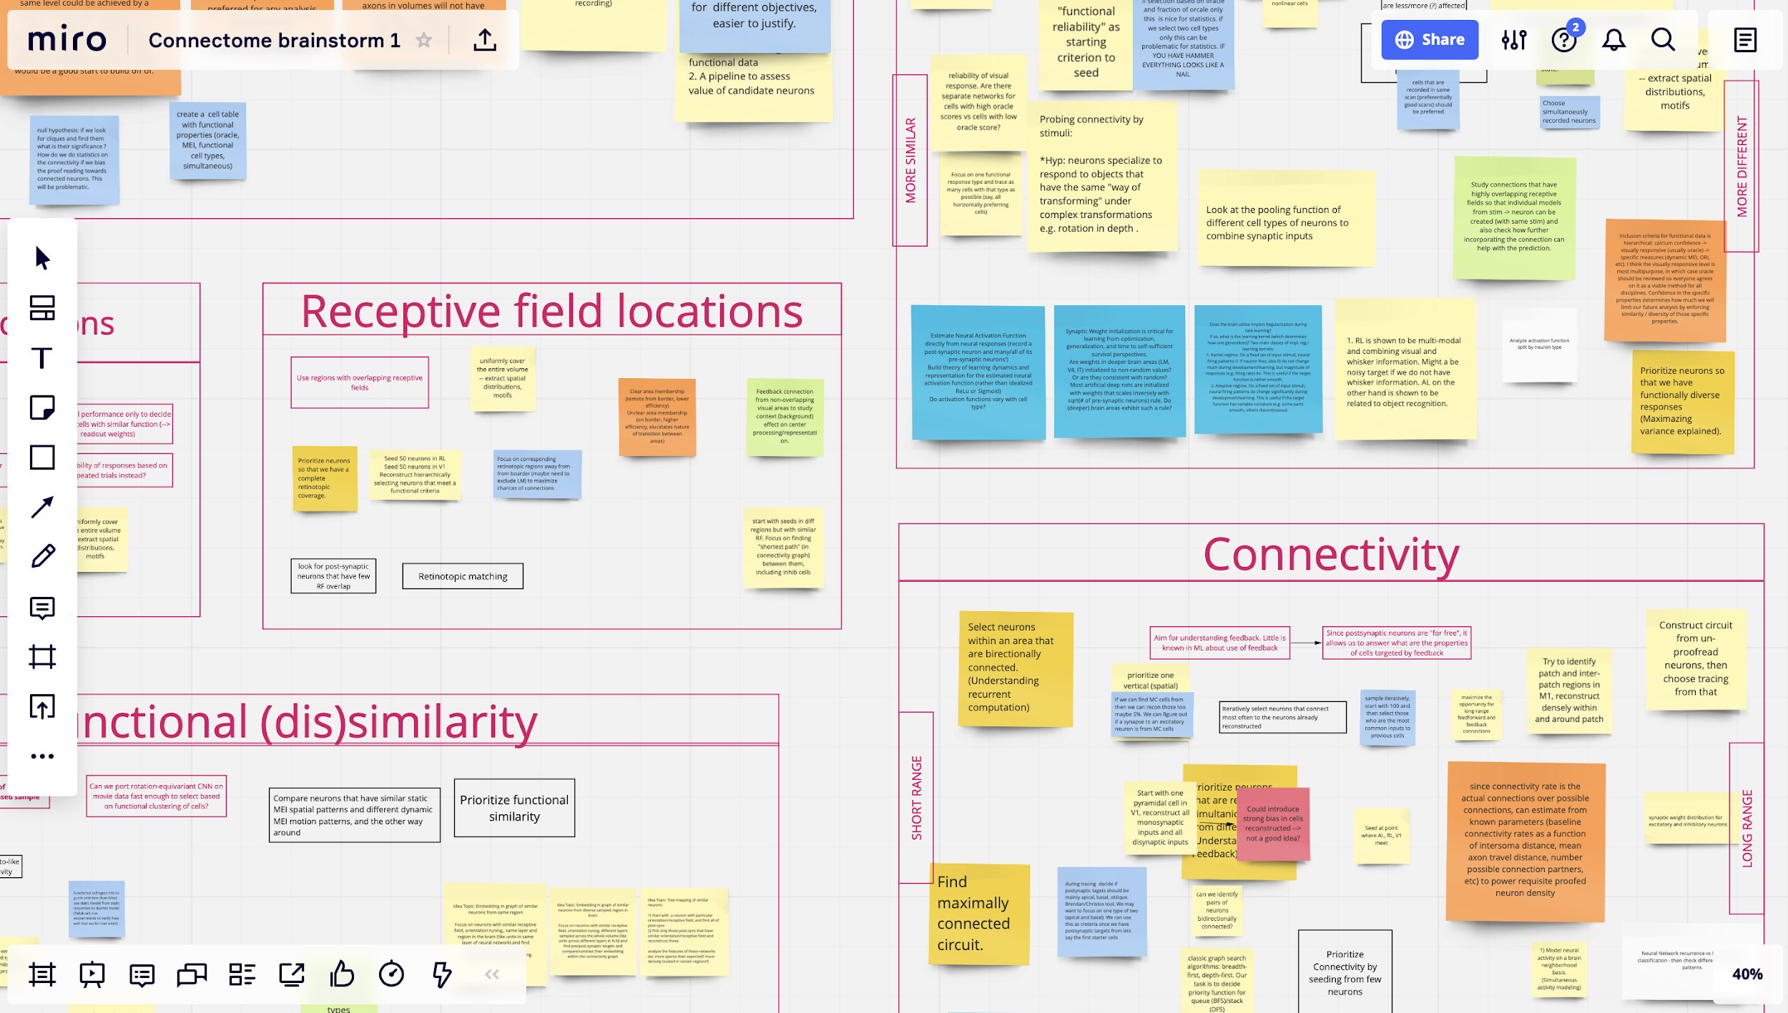
Group projects - Brainstorming
Miro.com:
3 free boards per person, unlimited collaborators
Fun! You can see others moving around and typing

Slide 133
Group projects - Brainstorming phases
Expansion
Free flow of ideas.
No judgement!
Start with quiet time (15 min) for independent idea generation.
Then each person briefly describes some ideas to pod
Encourage responses with sentences starting by “Yes, and…”
Associate ideas by affinity
Divide into breakout rooms (15 min) to discuss and organize
Contraction
Critique, modify, synthesize, prioritize
Stay supportive, stay realistic. Students only have about 20-30 hours for projects.

Slide 134
Group projects - groupings
TAs should facilitate organizing students into small groups
Help them find common project ideas (Week 1 Day 3)
Based on their own idea
Based on provided examples ideas
Matching should already group students in pods by similar interests
But students need to find consensus projects
Make sure students have compatible time commitments for project

Slide 135
Group projects - resources
We provide many project examples to get ideas flowing
Slide deck is here (under construction)
We recommend using curated datasets
Videos about these data are here

Slide 136
Group projects - Mentors
Five 30-min meetings planned with faculty mentors for conceptual guidance project discussions
Mentor 1: help brainstorming
Week 1, Day 3 or 4
Mentor 2: expert on project subject matter
Four meetings in Weeks 2, 3

Slide 137
Example Project topic: Decoding X from Y
Scientific context: Many scientific questions ask whether some brain signals Y contain information about some task variables X. Decoding provides a way to estimate that: if you can decode X from Y using some technique, then you know that information is present (though not necessarily used).
Specific question: Pick a variable of interest, like orientation, frequency, running… Then pick a type of brain signal, like firing rate, oscillation amplitude, time series… How are these quantities related?
Data set: Any.
Techniques:Many, both linear and nonlinear. Linear: regression, Support Vector Machines, Canonical Correlation Analysis, Granger Causality. Nonlinear: Directed Information, Neural Networks...
Controls: Cross-validate for held-out data. Causality is harder to establish.

Slide 138
Project topic: Encoding of facial movements in V1
Scientific context: It has been known since Niell and Stryker, 2010 that sensory areas are modulated by locomotion. Recently it has emerged that V1 and the brain as a whole also encodes finer details of an animal’s facial movements. Why?
Specific question: Can you determine which patterns of facial movement are encoded? That might contain hints about the function of these signals.
Data set: Stringer with spontaneous behaviors.
Techniques: For tracking fiducial points on the face: DeepLabCut/APT/LEAP/DeepPoseKit. For dimension reduction on spatiotemporal point cloud data: PCA, HMM, Gaussian Process Factor Analysis (GPFA). For regression prediction: reduced rank regression, ridge regression, deep networks.
Controls: Cross validation and establish baselines based on Stringer, Pachitariu et al, Science 2019.

Slide 139
Project topic: Reinforcement learning for foraging
Scientific context: Animals forage for food, integrating evidence and taking actions. Can this be explained by reinforcement learning problem.
Specific question: How should behavior on a foraging task depend on uncertainty, cost, dynamics?
Data set: None — theory project.
Techniques:Use Reinforcement learning or control to find optimal behavior on simple foraging tasks described in behavioral neuroscience literature. Model tasks by a Markov Decision Process. Reproduce published plots for animal behavior, but for optimal foraging.
Controls: Compare to simpler heuristic strategy.

Slide 140
Group projects - final thoughts
Projects are often key part of summer schools. Over zoom things will be different. Keep us updated about how things are going.
This is science! Most of what we try doesn’t work. That’s okay.
Be flexible and encouraging.

Slide 141
TA training -- Day 1 / Day 2

Slide 142
What’s the goal?
Days 1-2 are meta-modeling days
Students learn what models are
Students learn how to approach modeling from scratch
It’s about the thought process and the reasoning, not the specific models
We want students to think about what different models buy us
We want students to have a rational approach to modeling

Slide 143
Day 1 - models
Slightly different schedule from other days
45 min for each of the first 3 tutorials
45 min for TA-led discussion at the end!
Use 1st tutorial to demo peer-programming!
Then send students into break-out rooms for T 2-3
TA-led discussion slides

Slide 144
Day 1 - Guided questions (from slides)
These are the same questions after tutorials 1-3
Have you seen what/how/why models before?
Have you ever done one?
Why are what/how/why models useful?
When are they possible? Does your field have why models?
What do we learn from constructing them?

Slide 145
Day 1 - Guided questions (from slides)
Then follows a group discussion
What is your favorite model ever
Every student contributes one. Can not reuse the same
Which models when?
For which questions do you prefer what models?
How models?
Why models?
Which model kinds do you like best?
Why?
Would you be missing something if the other models did not exist?

Slide 146
Day 2 - how-to-model
Regular schedule, but
Many discussion points that should be TA-guided
Specific discussion for end of tutorial 1 time: model toolkit selection!
TA-led discussion slides

Slide 147
TA training --
Pre-course Python Workshop

Slide 148
Objectives
Basic Python for NMA notebooks
Build and visualize neural simulation

Slide 149
Workshop students
Some programming
Basic neuroscience
College-level math

Slide 150
Pedagogical approach
Assume basic knowledge
Start simple
Build iteratively

Slide 151
Pedagogical approach
Assume basic knowledge (Python, neuro and math)
Start simple
Build iteratively

Slide 152
Pedagogical approach
Coding end-to-end
Python leads to neuro
Exercises build confidence

Slide 153
Python for NMA - Day 1

Slide 154
Python
Neuro
Variable names
Numbers, strings & boolean
Print & formatting
Comments & line breaks
LIF neuron model
Membrane equation

Slide 155
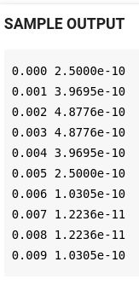
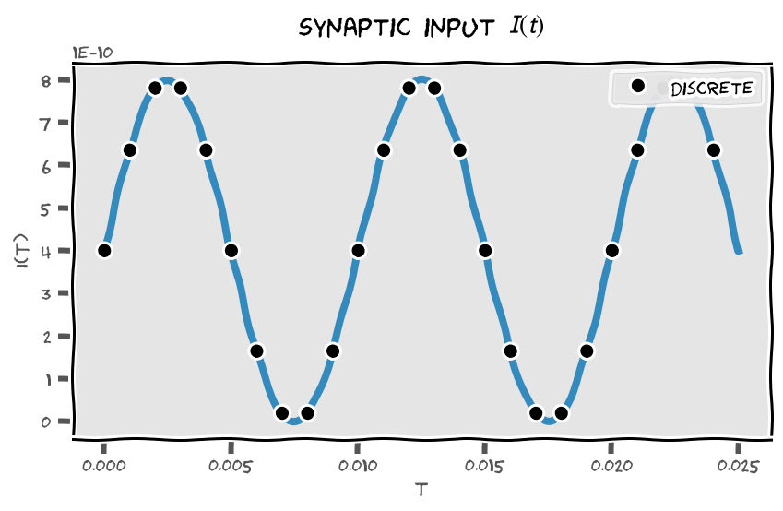
(Exercise 1, 2 and 3)
Encode simulation params
Synaptic input
Print formatting

Slide 156
Python
Neuro
For loop
Indentation
If condition
Euler integration

Slide 157
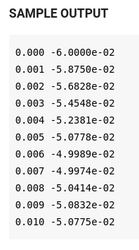
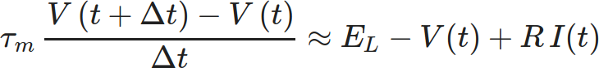
(Exercise 4)
Discrete time integration

Slide 158
Python
Neuro
Plotting

Slide 159
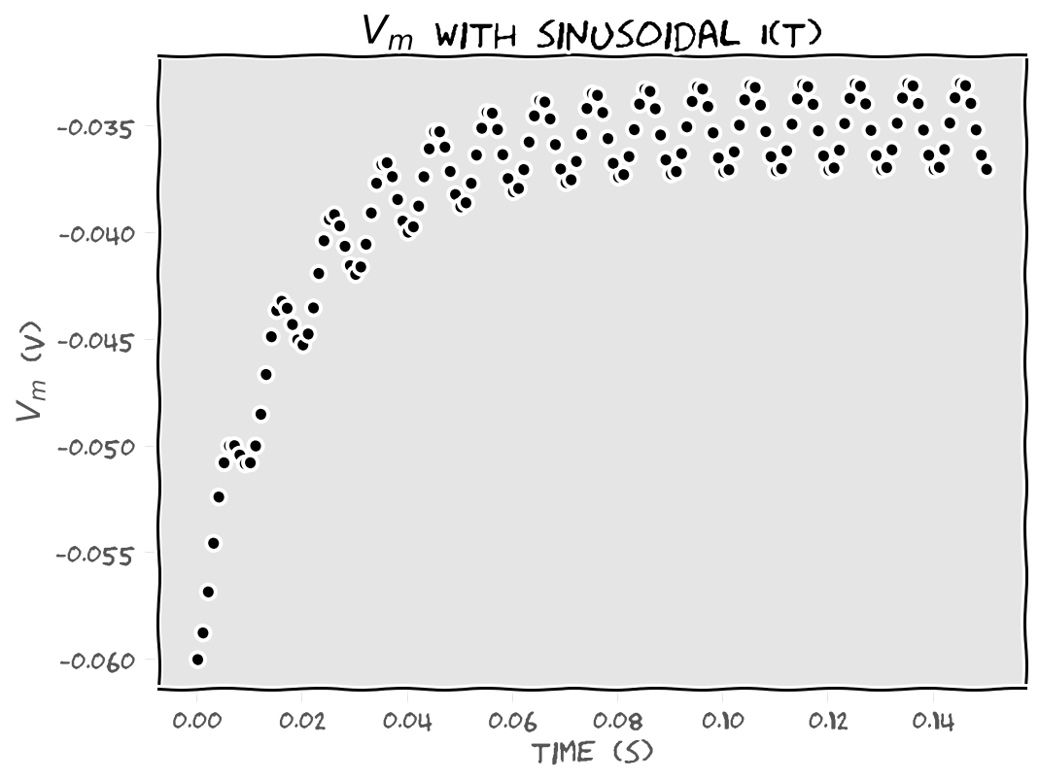
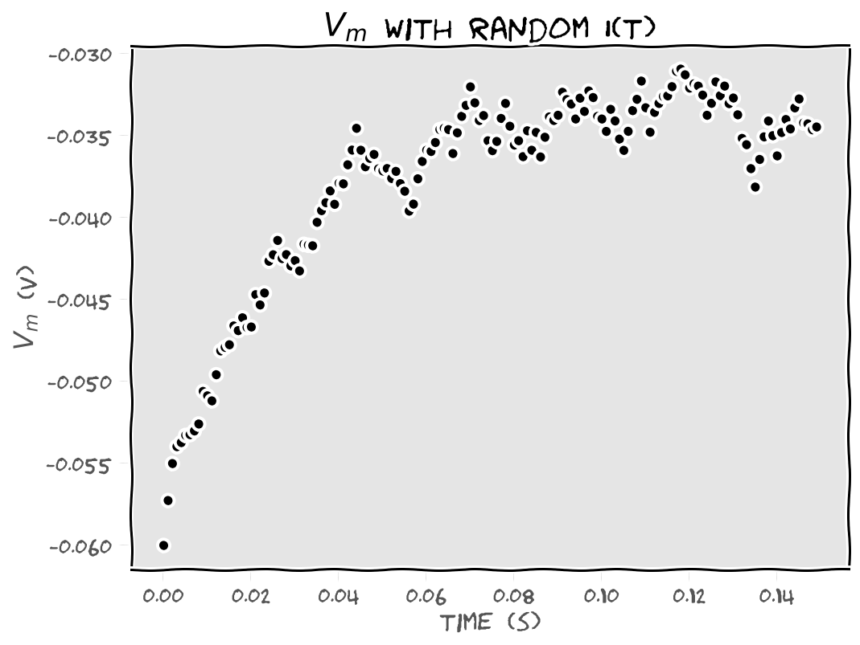
(Exercise 5, 6 and 7)
Plot I(t) and V(t)
Random synaptic input

Slide 160
Python
Neuro
Lists, indexing & slicing
Ensemble stats

Slide 161
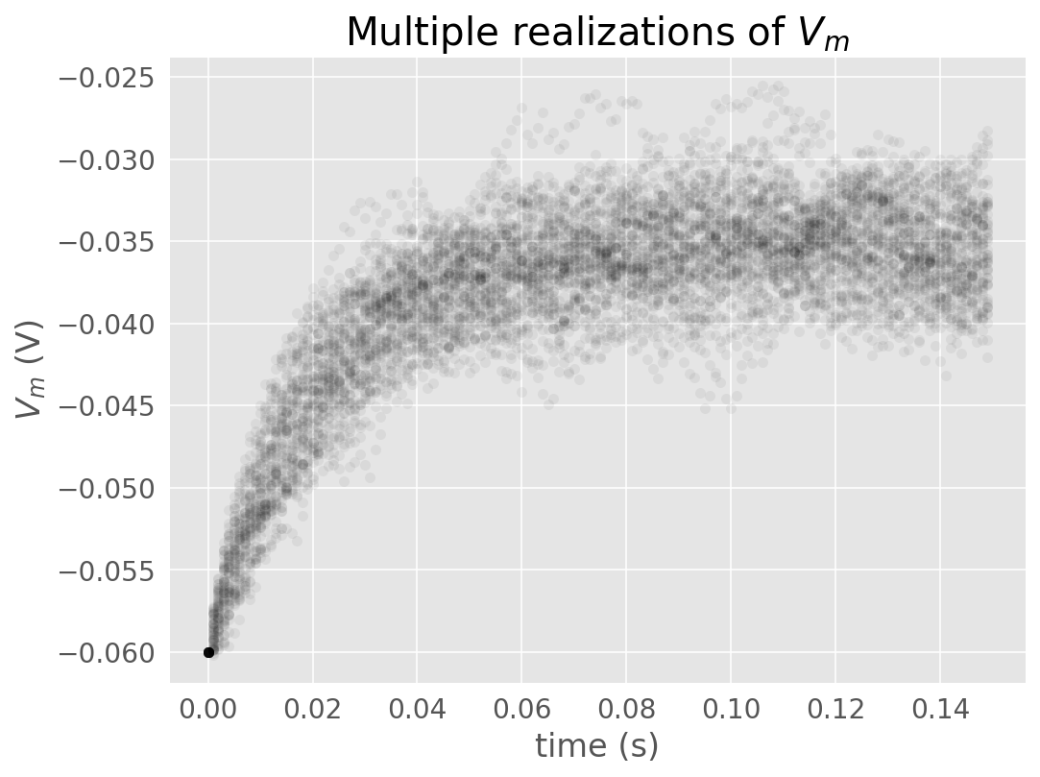
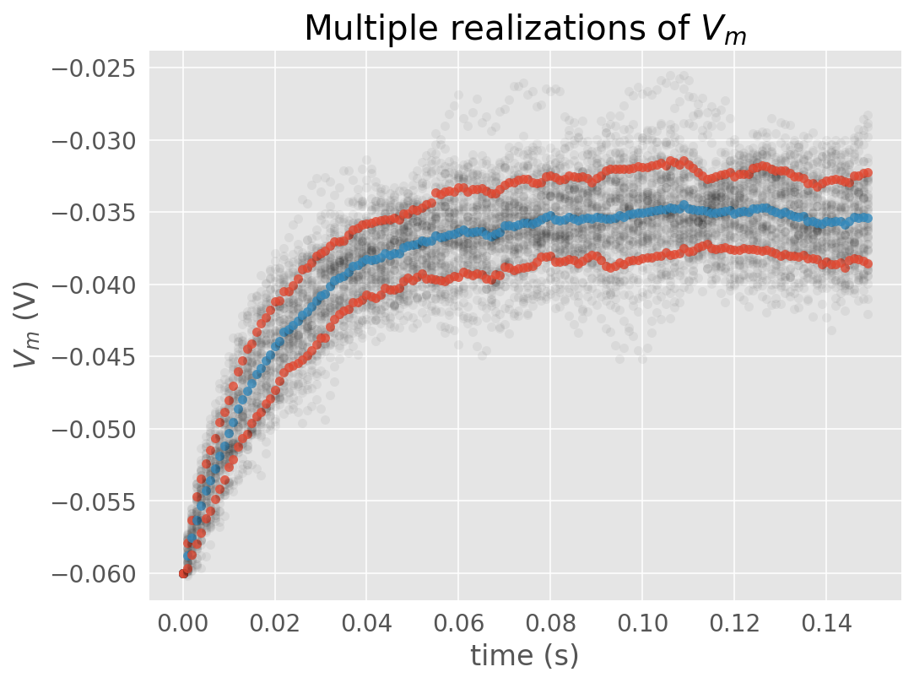
(Exercise 8, 9 and 10)
Ensemble statistics

Slide 162
Python
Neuro
Numpy arrays & aggregation

Slide 163
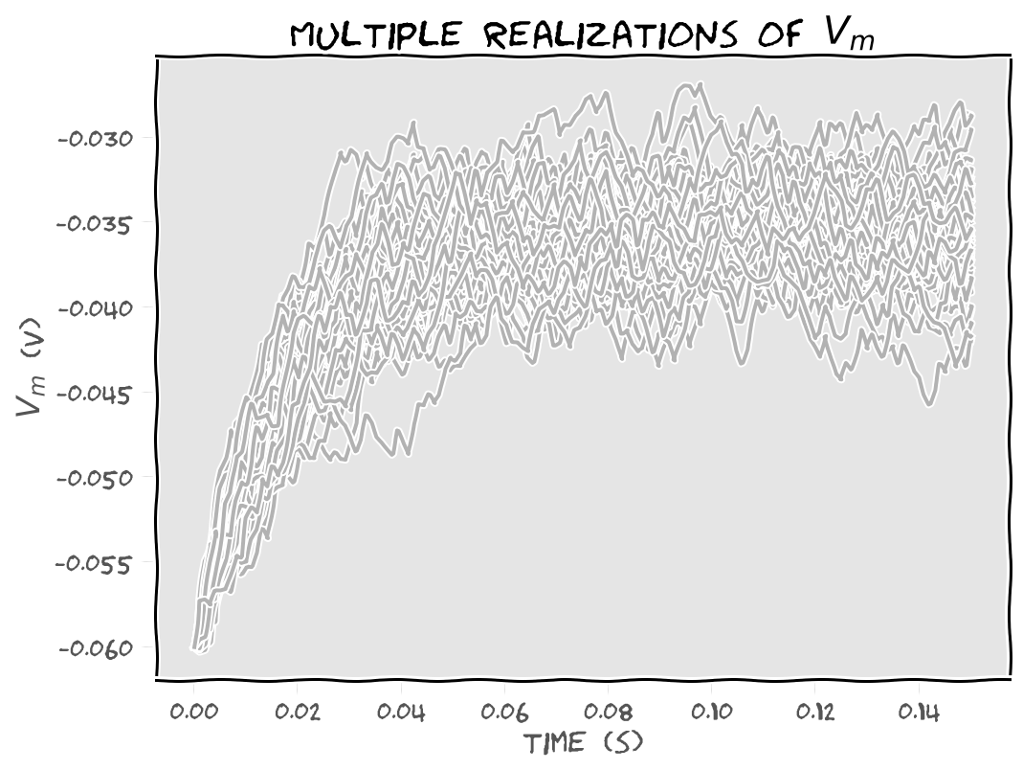
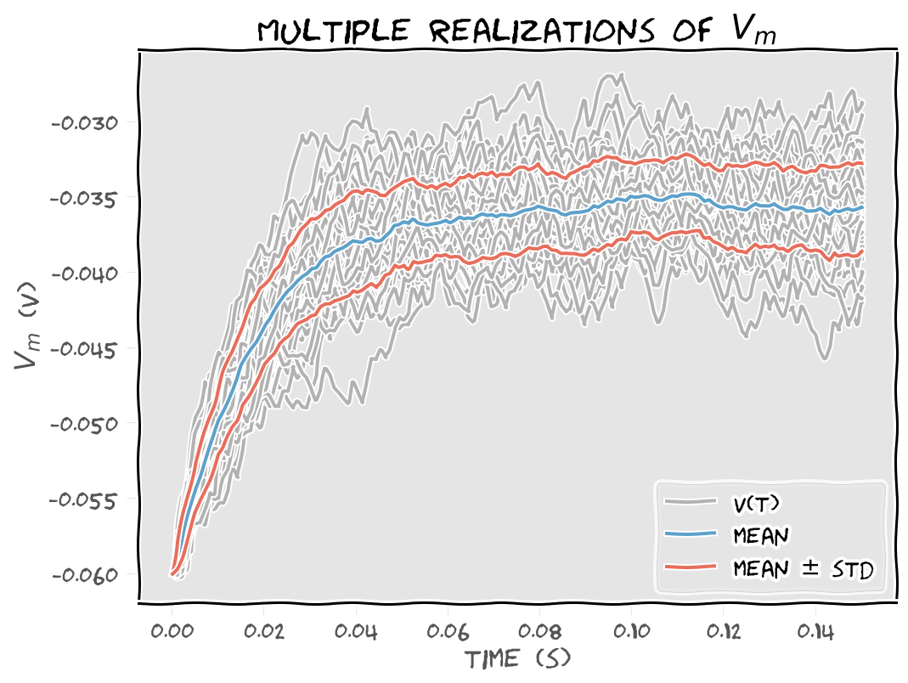
(Exercise 11, 12, 13 and 14)
Using Numpy
Loop with enumerate

Slide 164
Python for NMA - Day 2

Slide 165
Python
Neuro
Histogram

Slide 166
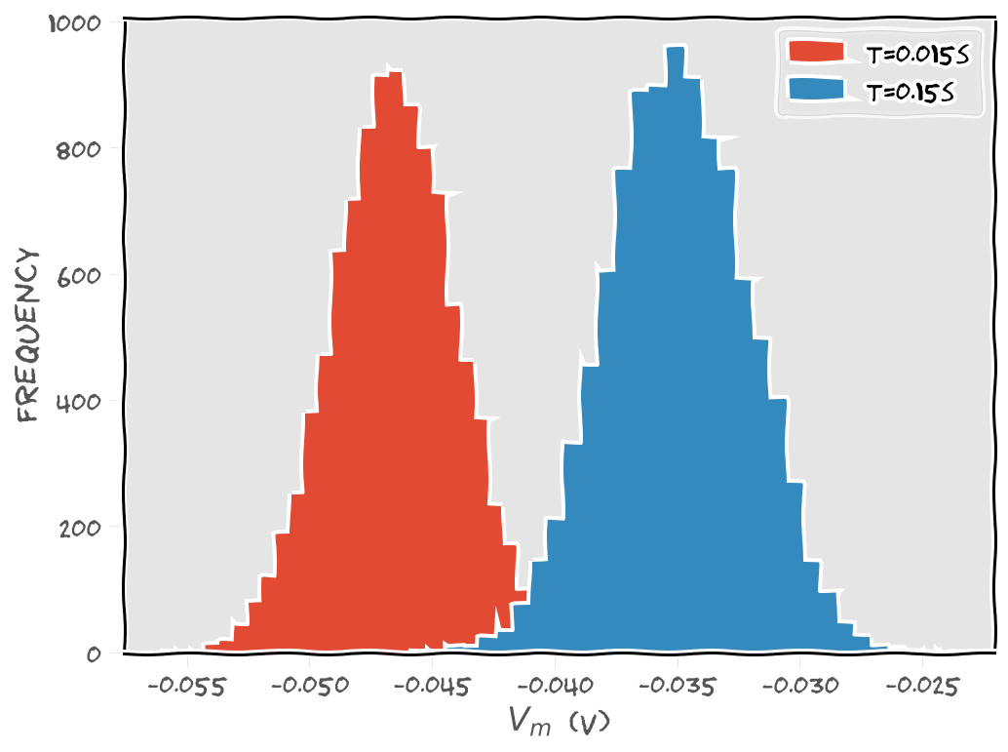
(Exercise 1, 2 and 3)
Histogram

Slide 167
Python
Neuro
Dictionaries
Spiking

Slide 168
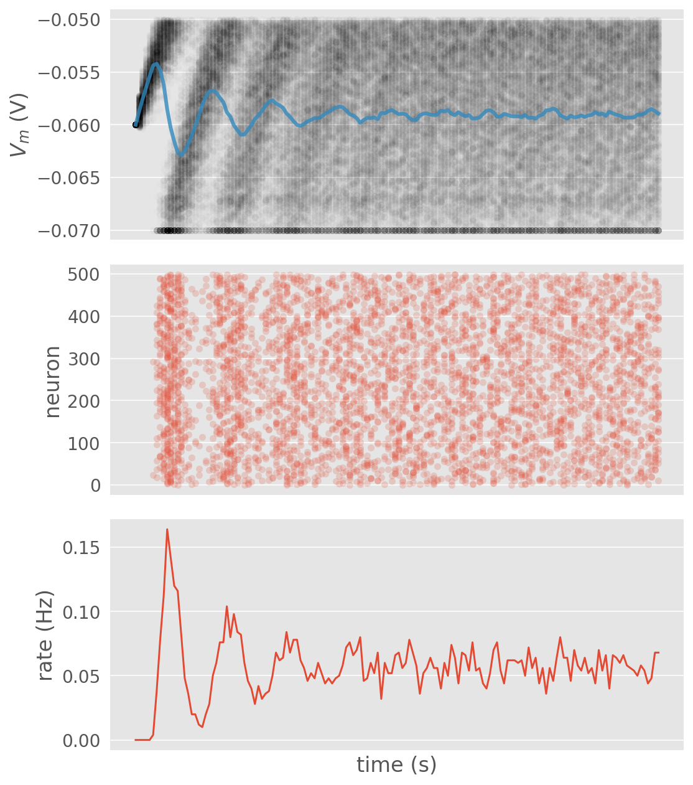
(Exercise 2)
Neuron spikes

Slide 169
Python
Neuro
Boolean indexes
Broadcasting

Slide 170
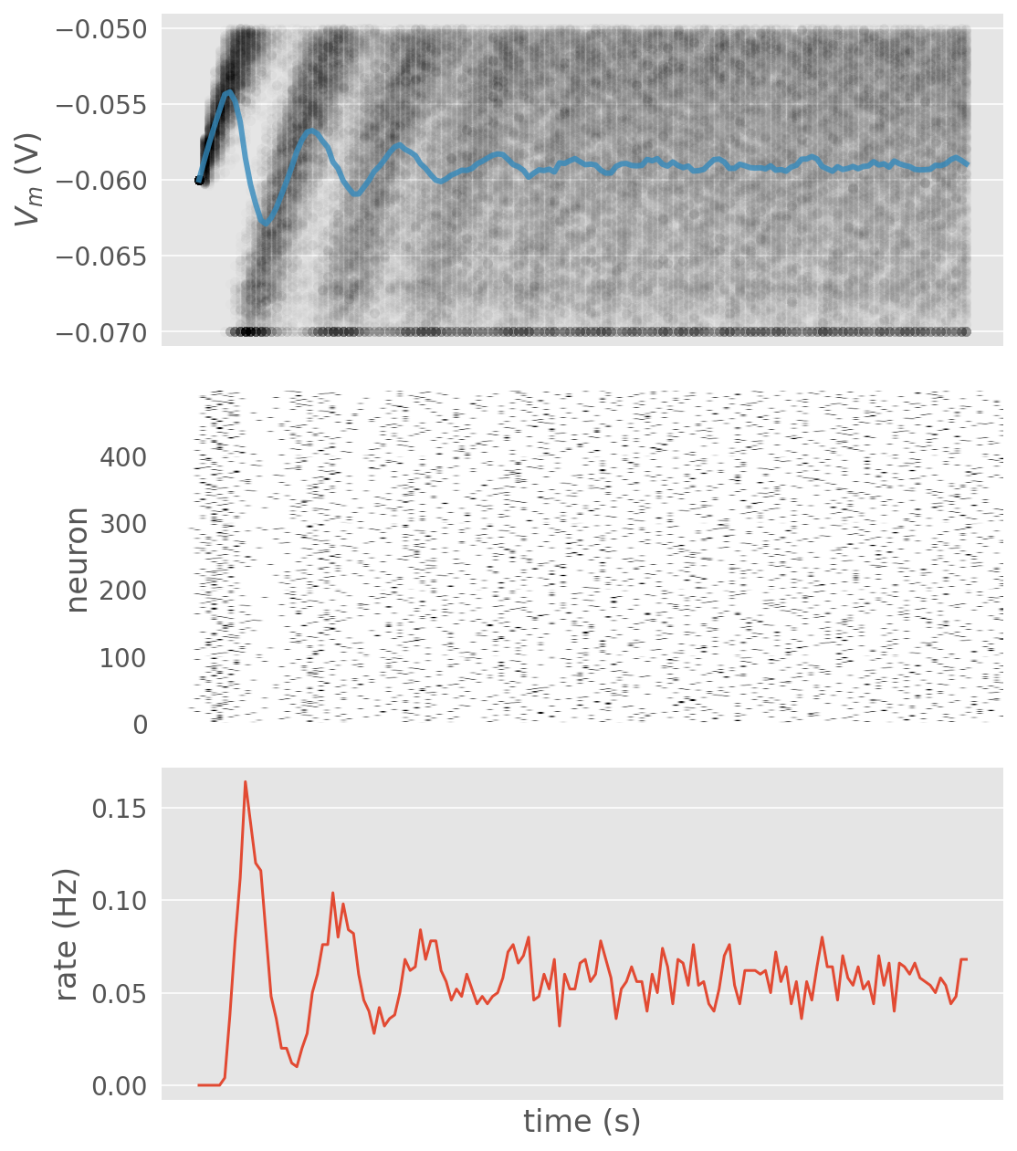
(Exercise 3 and 4)
Boolean indexes

Slide 171
Python
Neuro
Refractory period

Slide 172
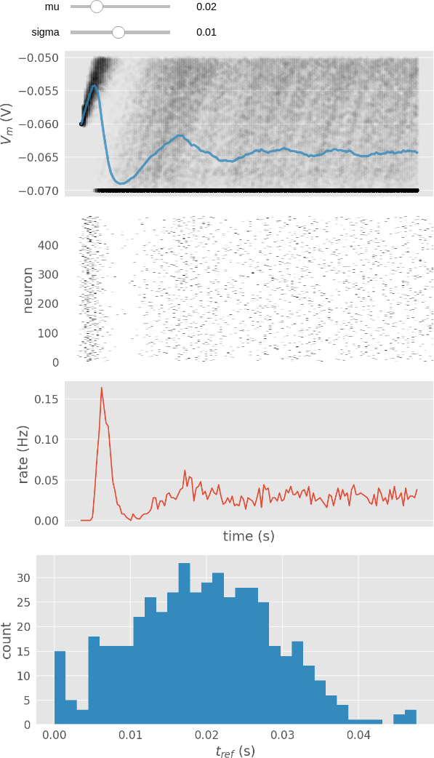
(Exercise 5, demo)
Boolean indexes

Slide 173
Python
Neuro
Functions
Classes
Modules
Tuples
Sets

Slide 174
(Exercise 6 and 7)
Using functions
Using classes

Slide 175
TA training -- Q&A

